Slide 1

Project Presentation project Docker
Rajyalakshmi Akshaya Raja | 200117
Functional Test Engineer | AQE

Slide 2
CONTENTS
Creating a Springboot project in spring initializr
Importing the project into Eclipse IDE
Displaying the text on browser using localhost
Creating a Docker file
Creating jar files
Creating Docker Images, deploying the text using the Docker
Pushing the docker file into the docker hub
Executing Selenium for the Springboot Project

Slide 3
CREATING A SPRINGBOOT PROJECT

Slide 4
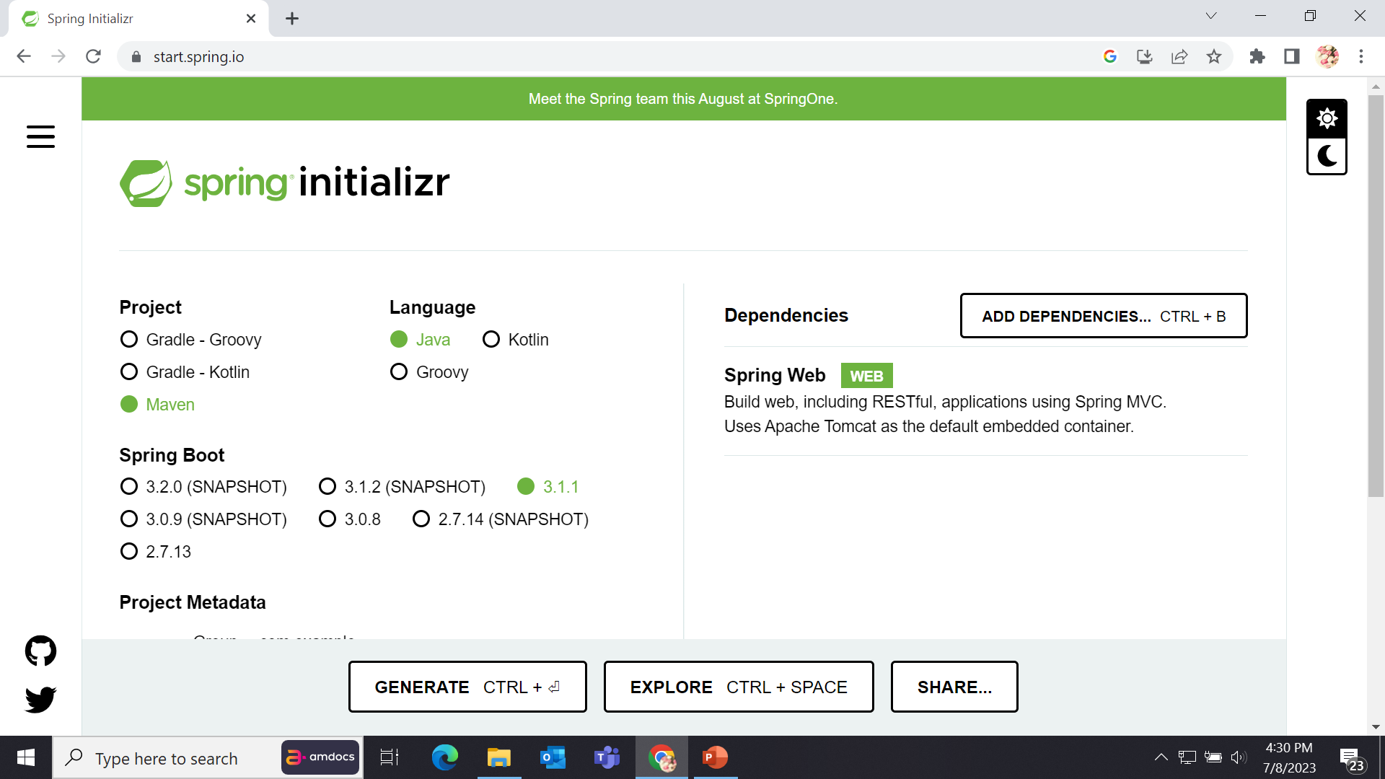
Step 1: Open Spring Initializer in browser

Slide 5
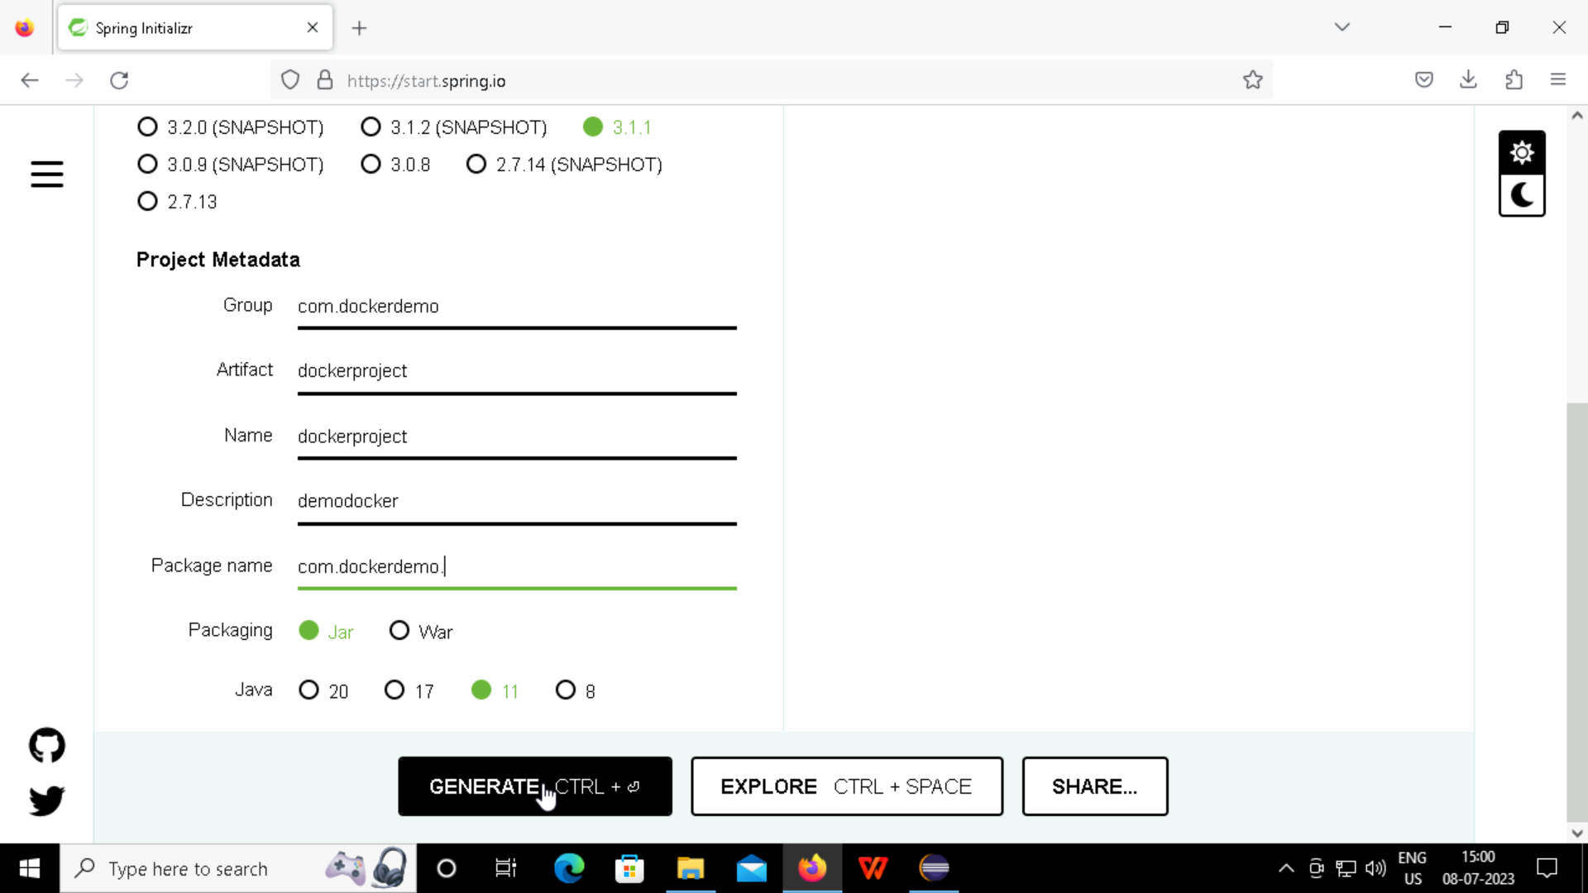
Step 2: Select a maven project, give the group, artifact and dependencies and generate a maven project.

Slide 6
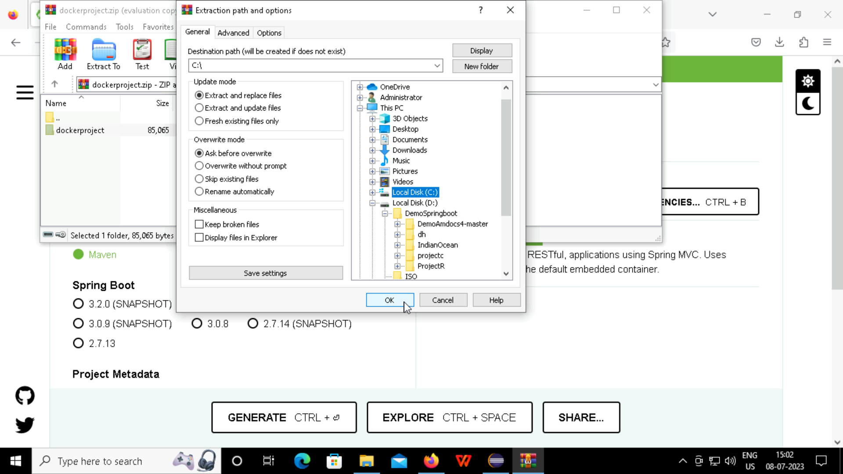
Step 3: Extract the generated project into the local disk, where you created a folder.

Slide 7
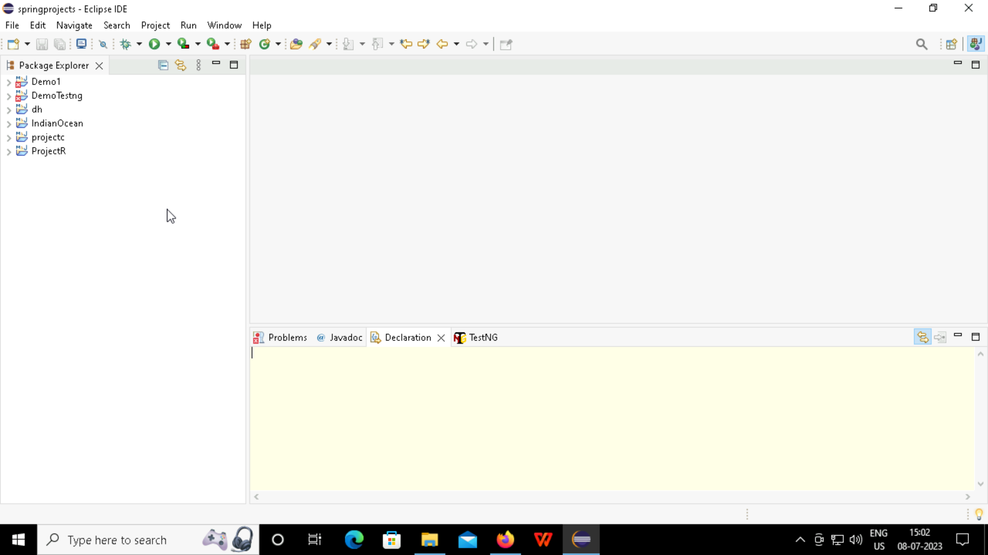
Step 4: Open Eclipse IDE and this is how the platform looks like.

Slide 8
IMPORTING THE FILE TO ECLIPSE

Slide 9
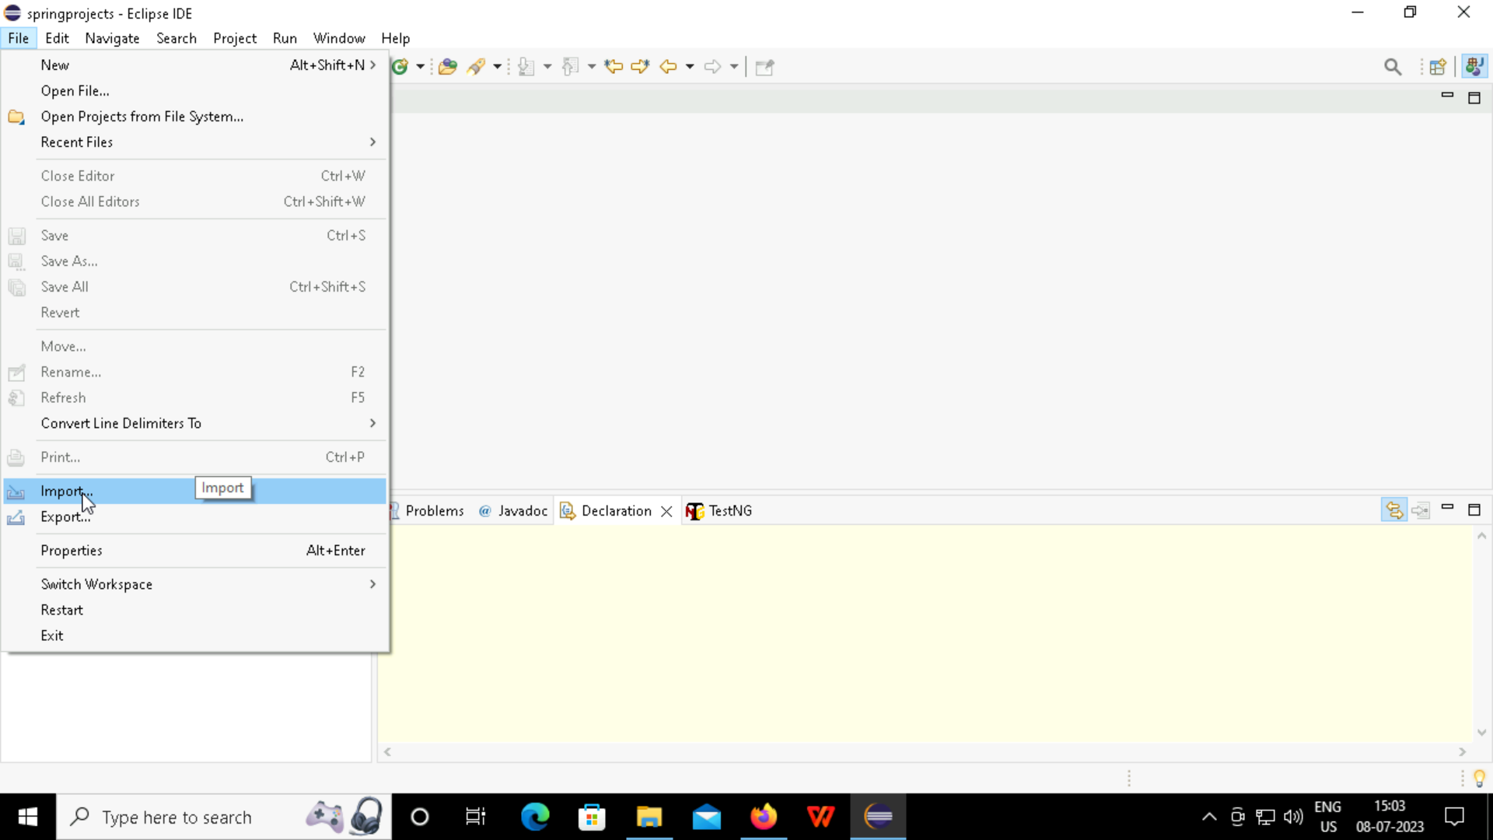
Step 1: File > Import > Existing Maven Projects

Slide 10
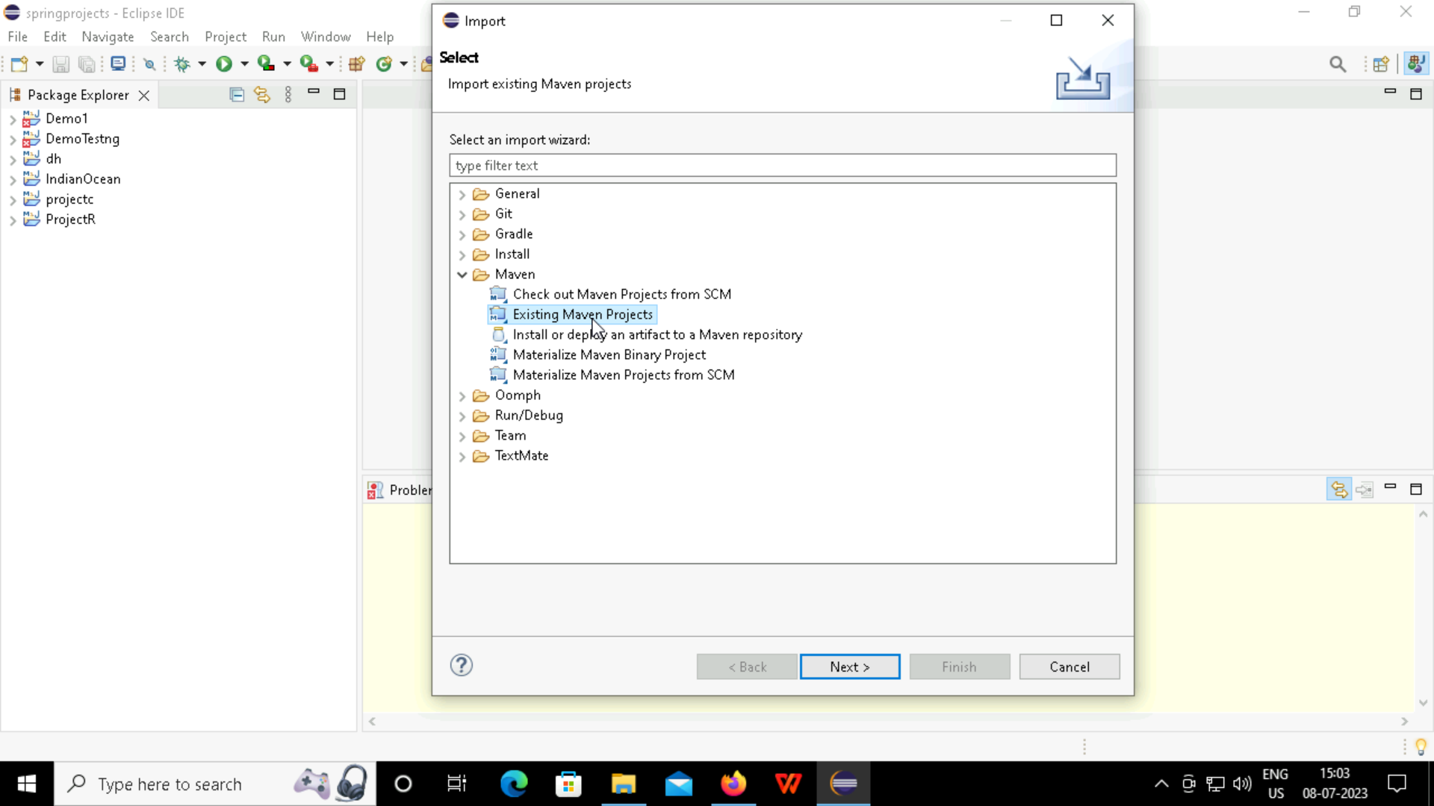

Slide 11
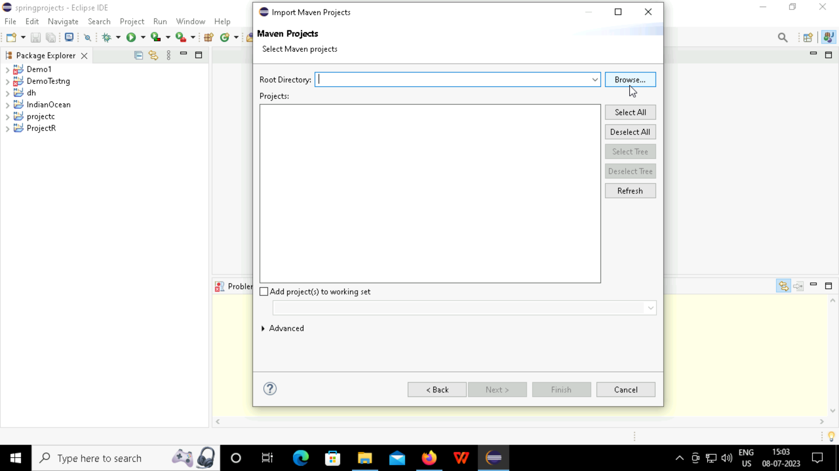
Step 2: Browse the required files from the root directory

Slide 12
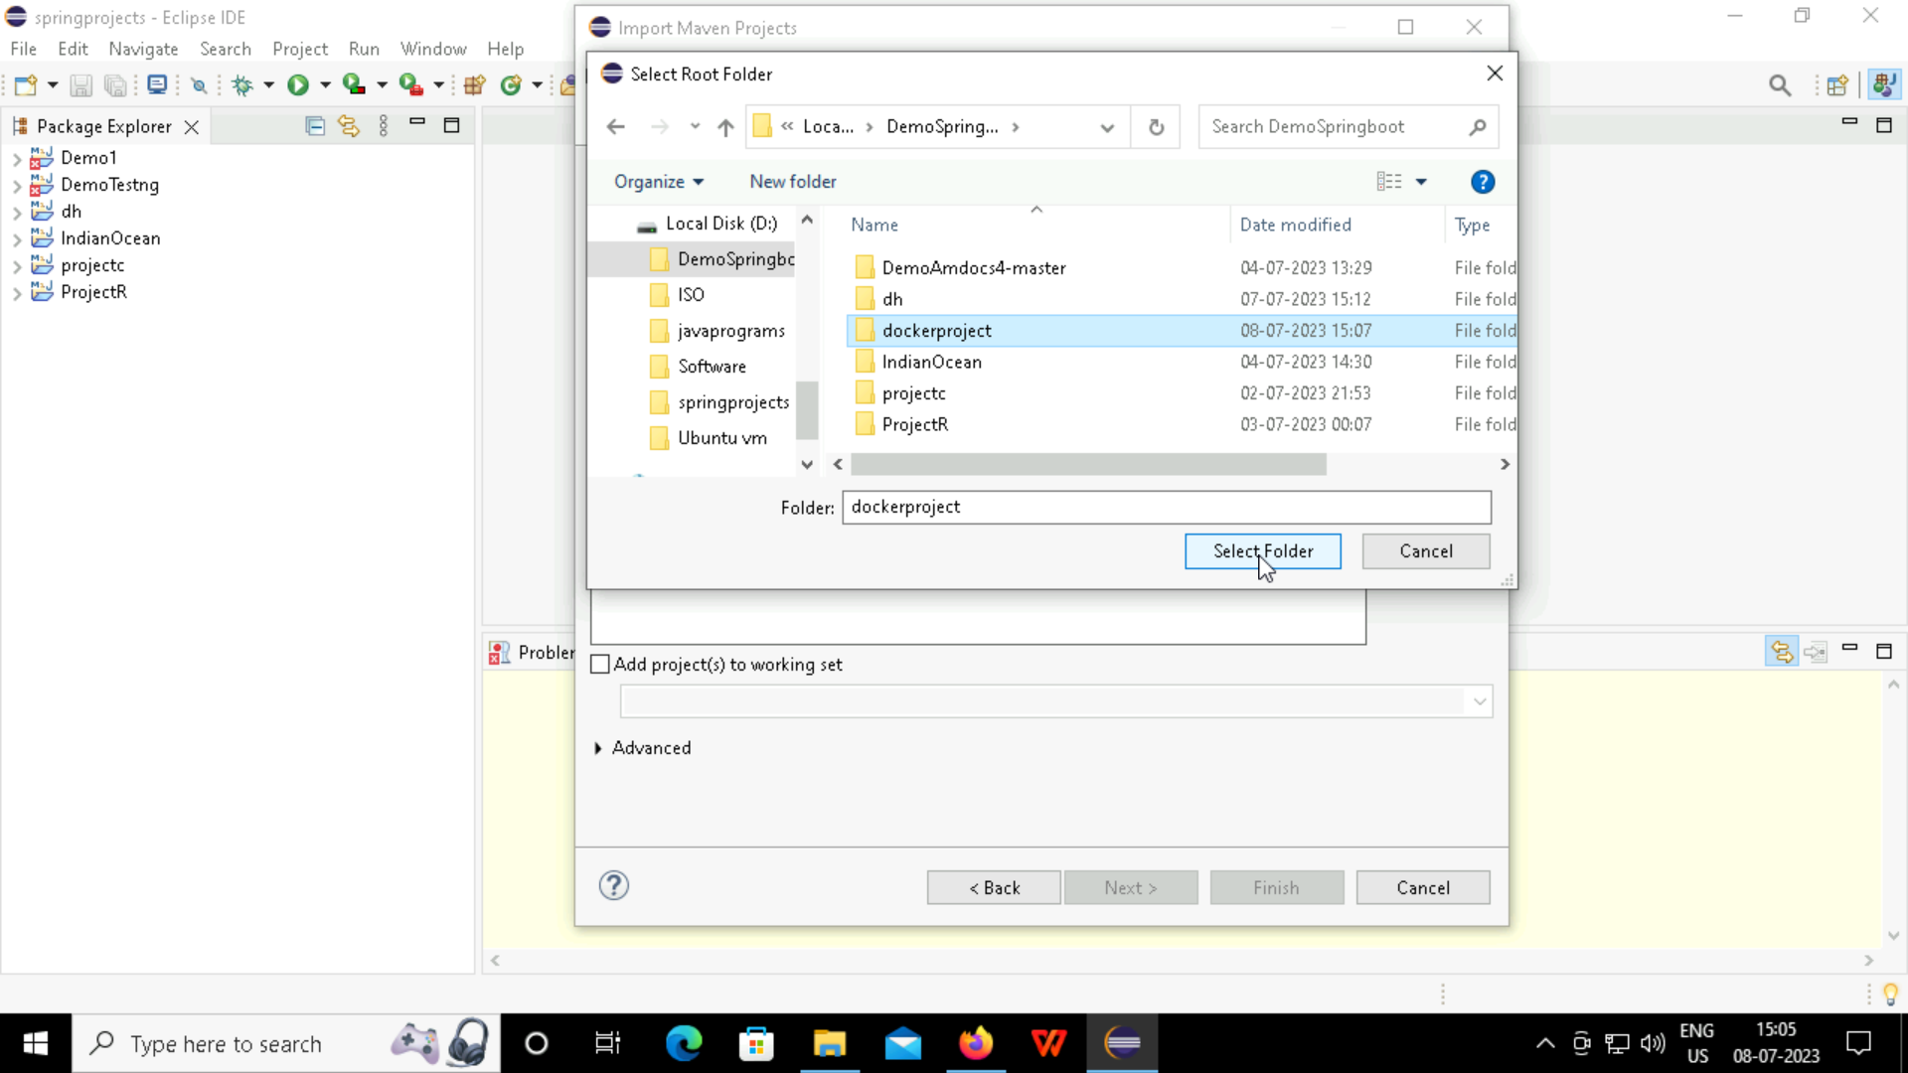
Step 3: Select the required project name

Slide 13
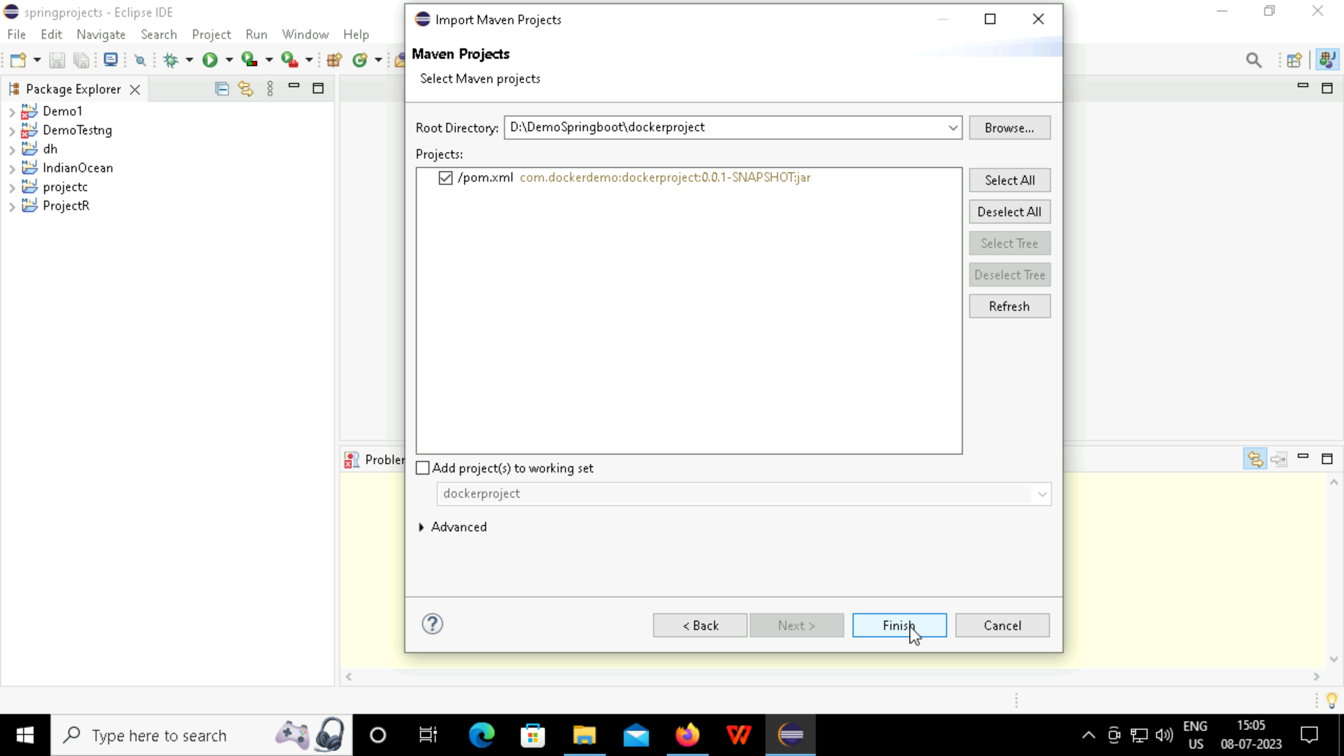
Step 4: Select finish

Slide 14
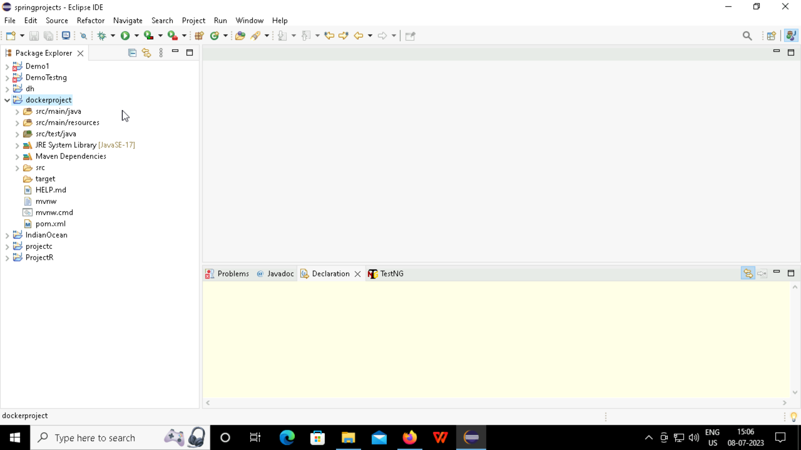
Step 5: The Maven project is imported into the Eclipse and the libraries are constructed.

Slide 15
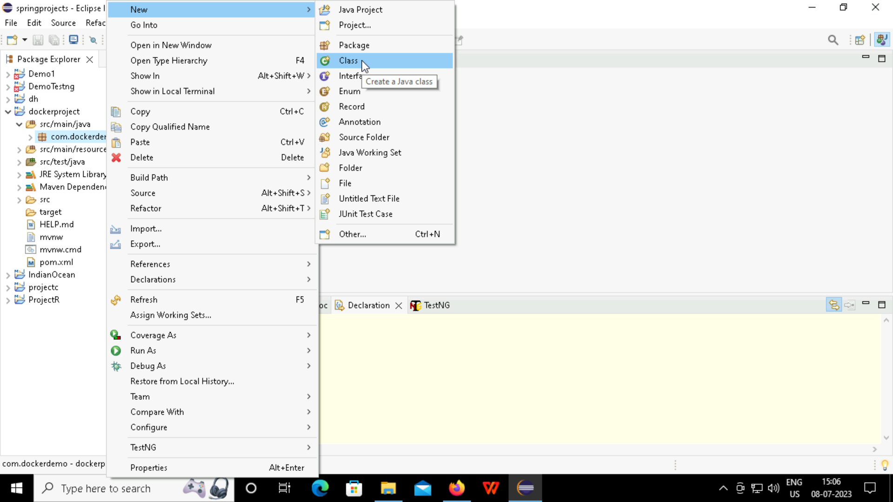
Step 6: Create a new class in the project so that the text can be deployed in the browser.

Slide 16
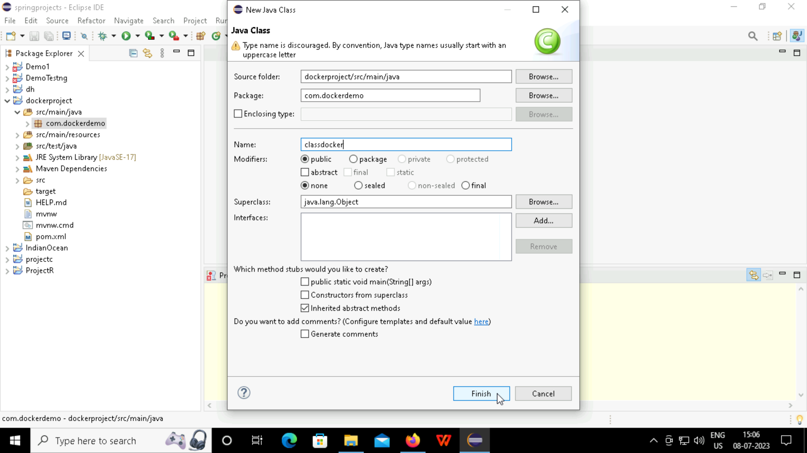

Slide 17
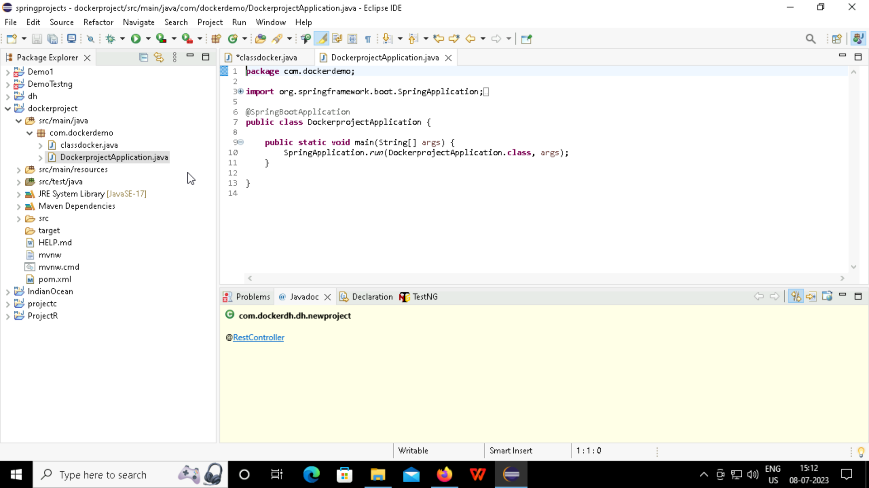
Step 7: This is how a docker application looks like.

Slide 18
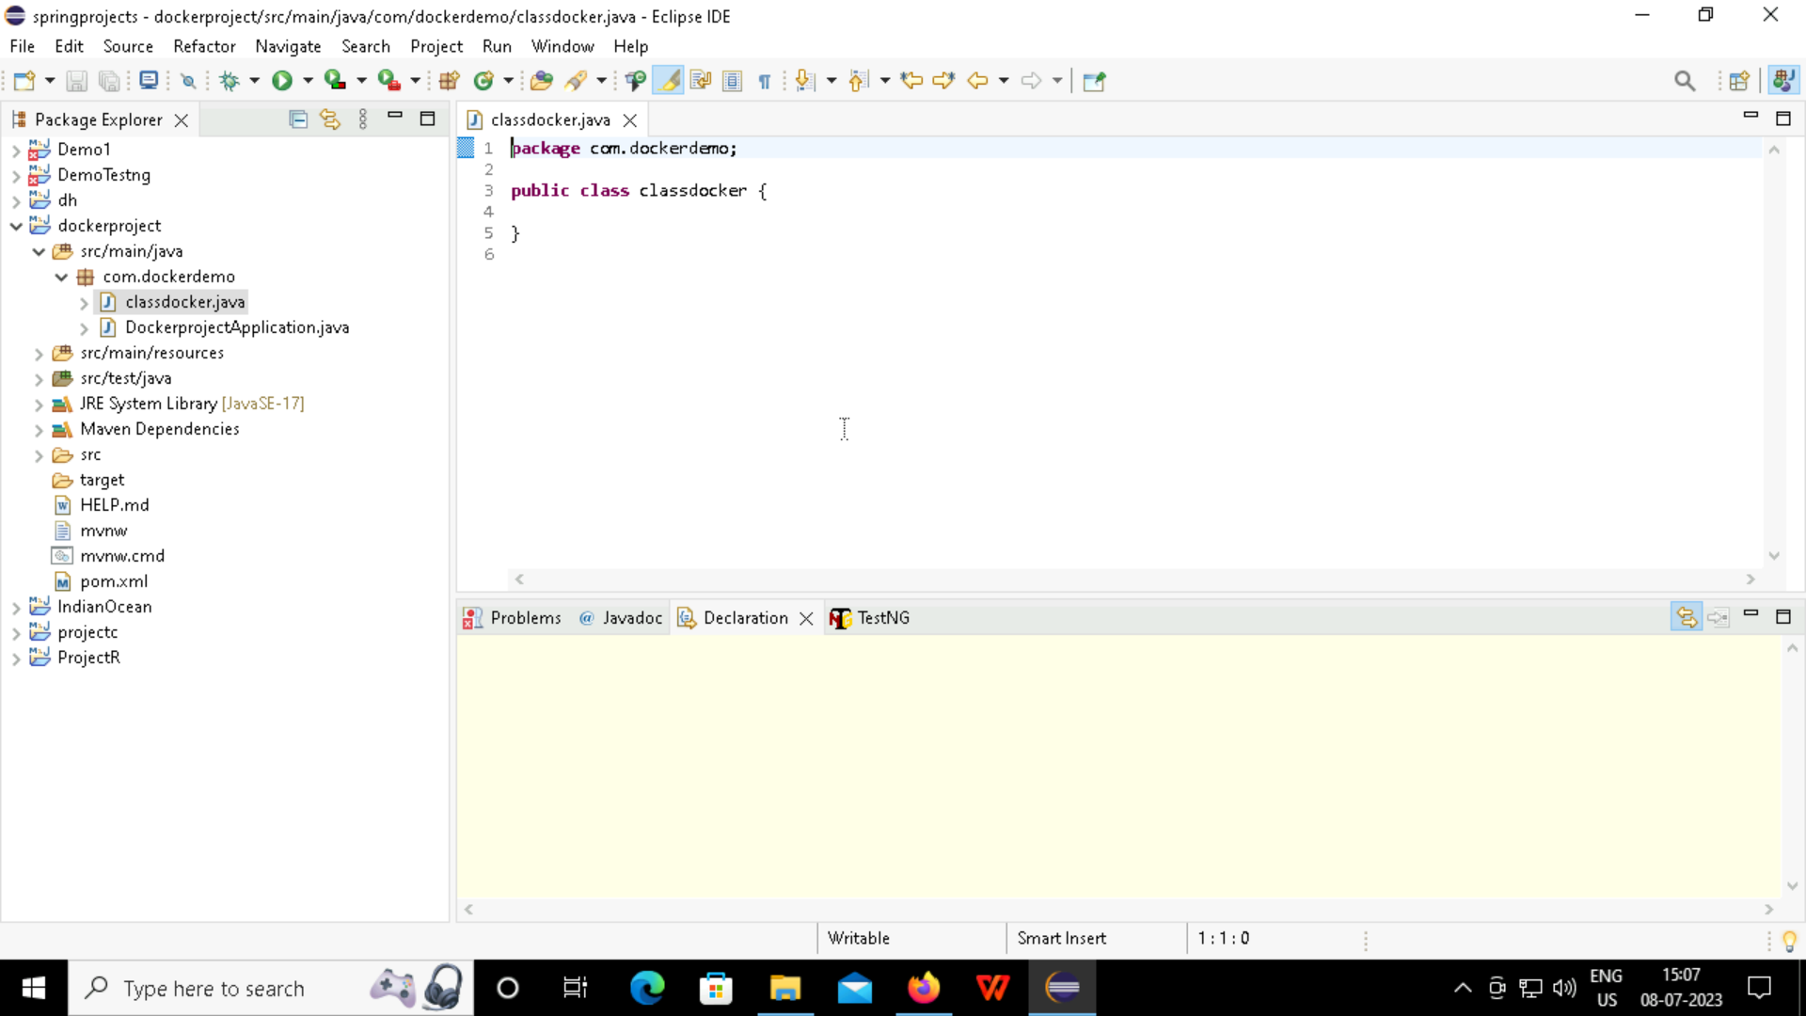
Step 8: This is the new Class that has been created earlier.

Slide 19
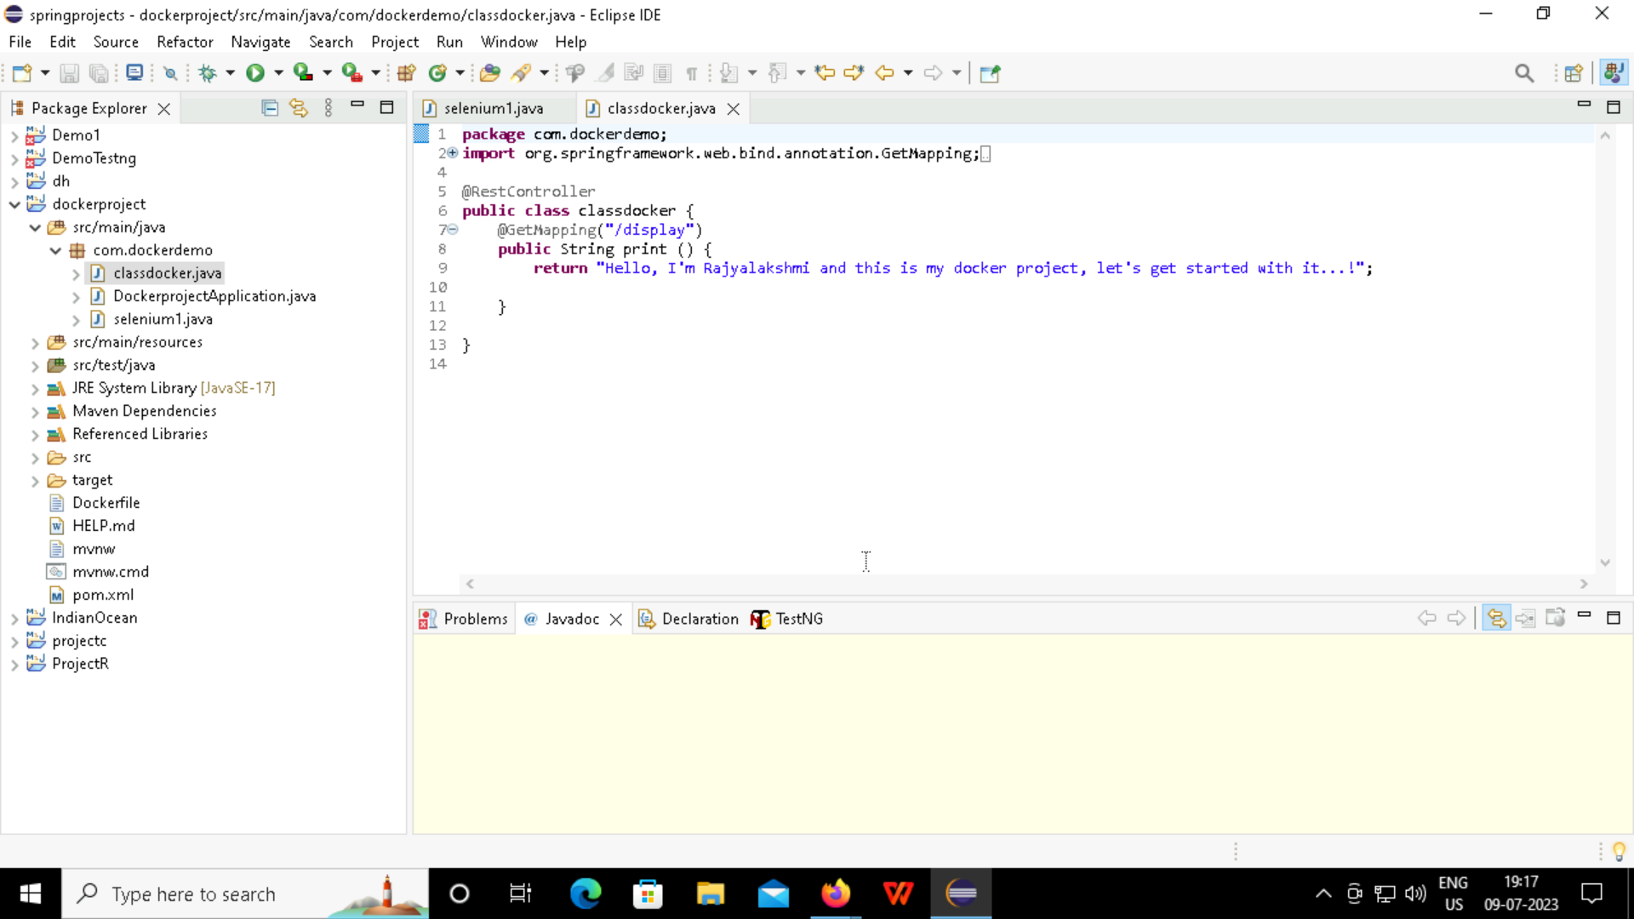
Step 9: Write the code and the text you wanted to display in the browser.

Slide 20
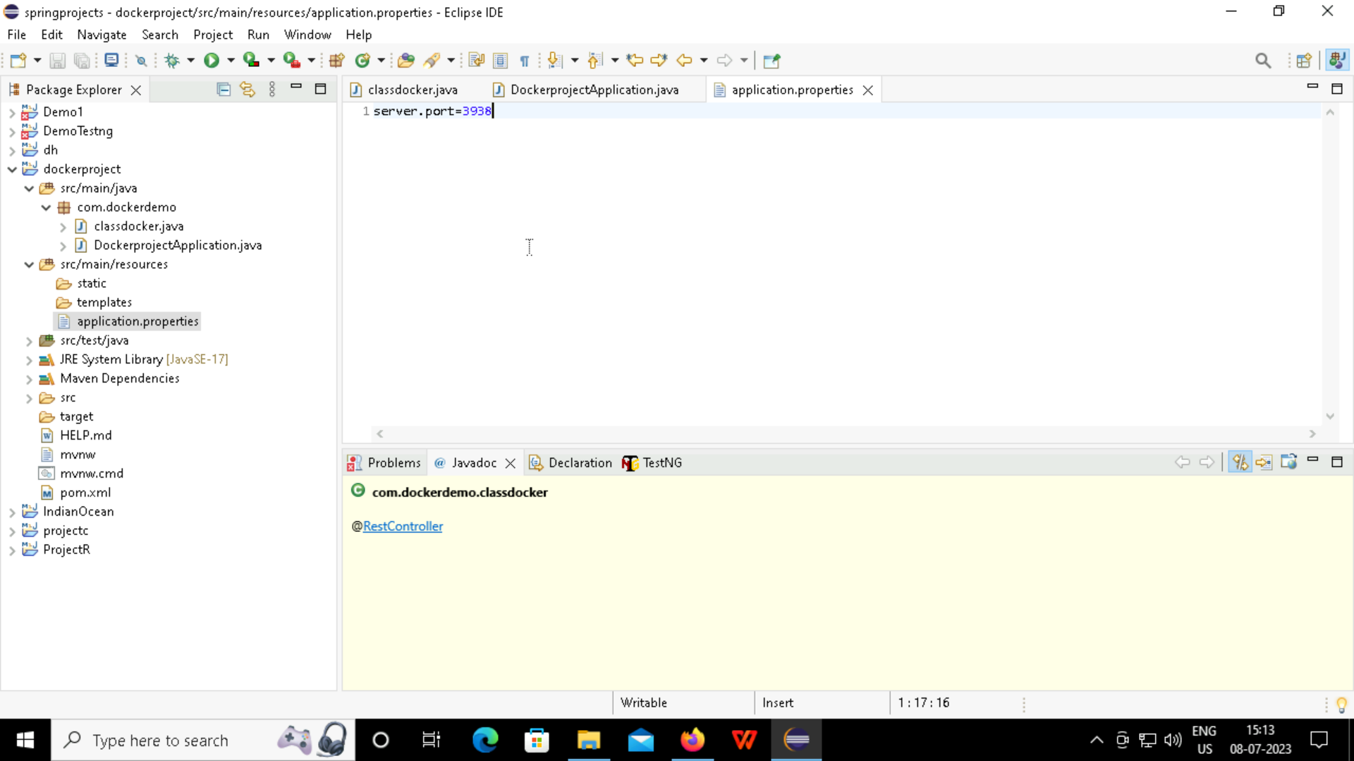
Step 10: In the application.properties, give the new port number so that the port displays the text.

Slide 21
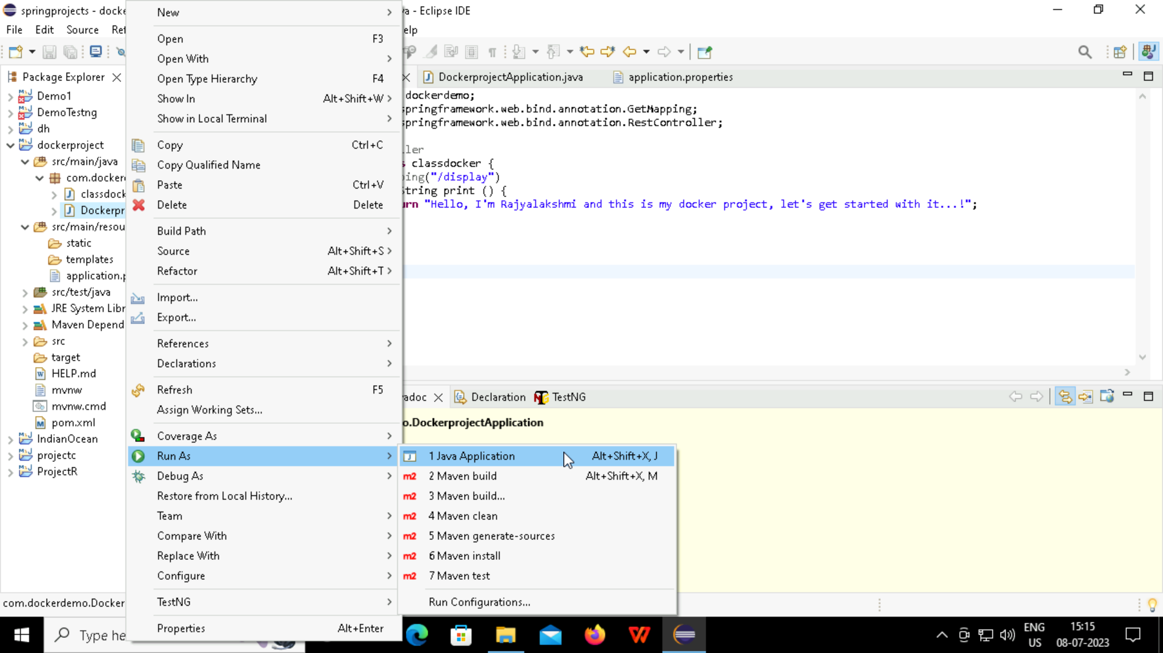
Step 11: Now run the code as 1 Java application.

Slide 22
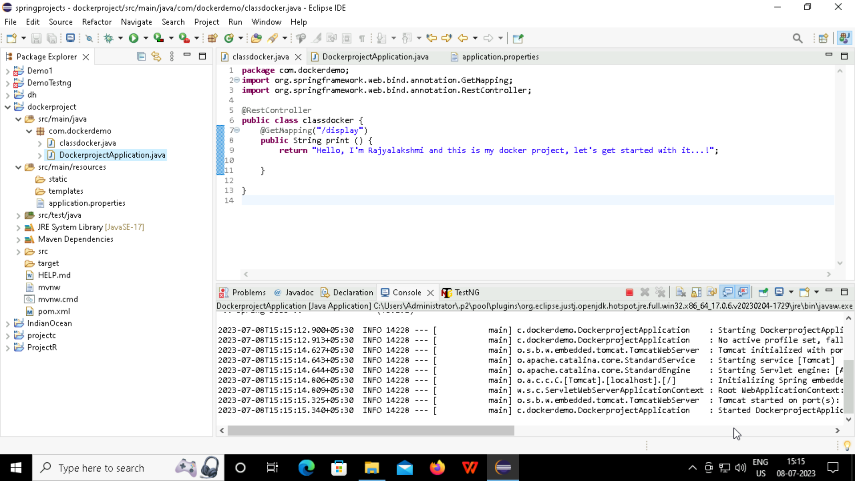
Step 12: The output shows then Started dockerproject application

Slide 23
DISPLAYING THE TEXT ON BROWSER USING LOCALHOST

Slide 24
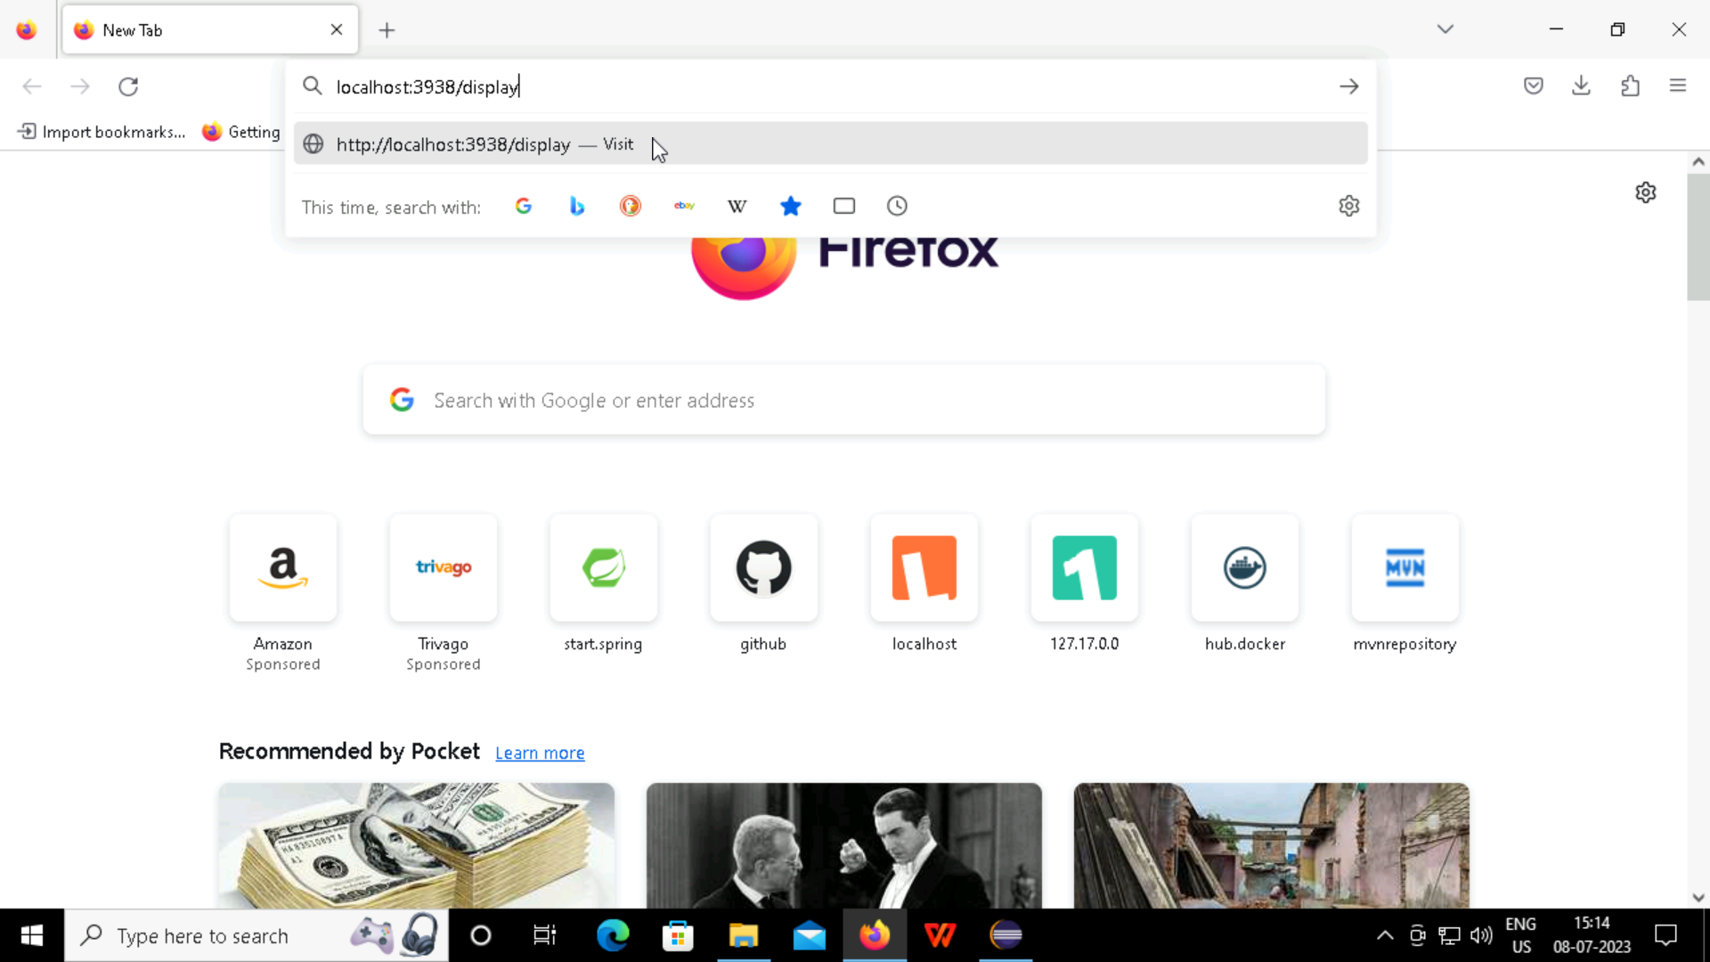
Step 1: Go to the browser and type “localhost (port number)/display” and then enter.

Slide 25
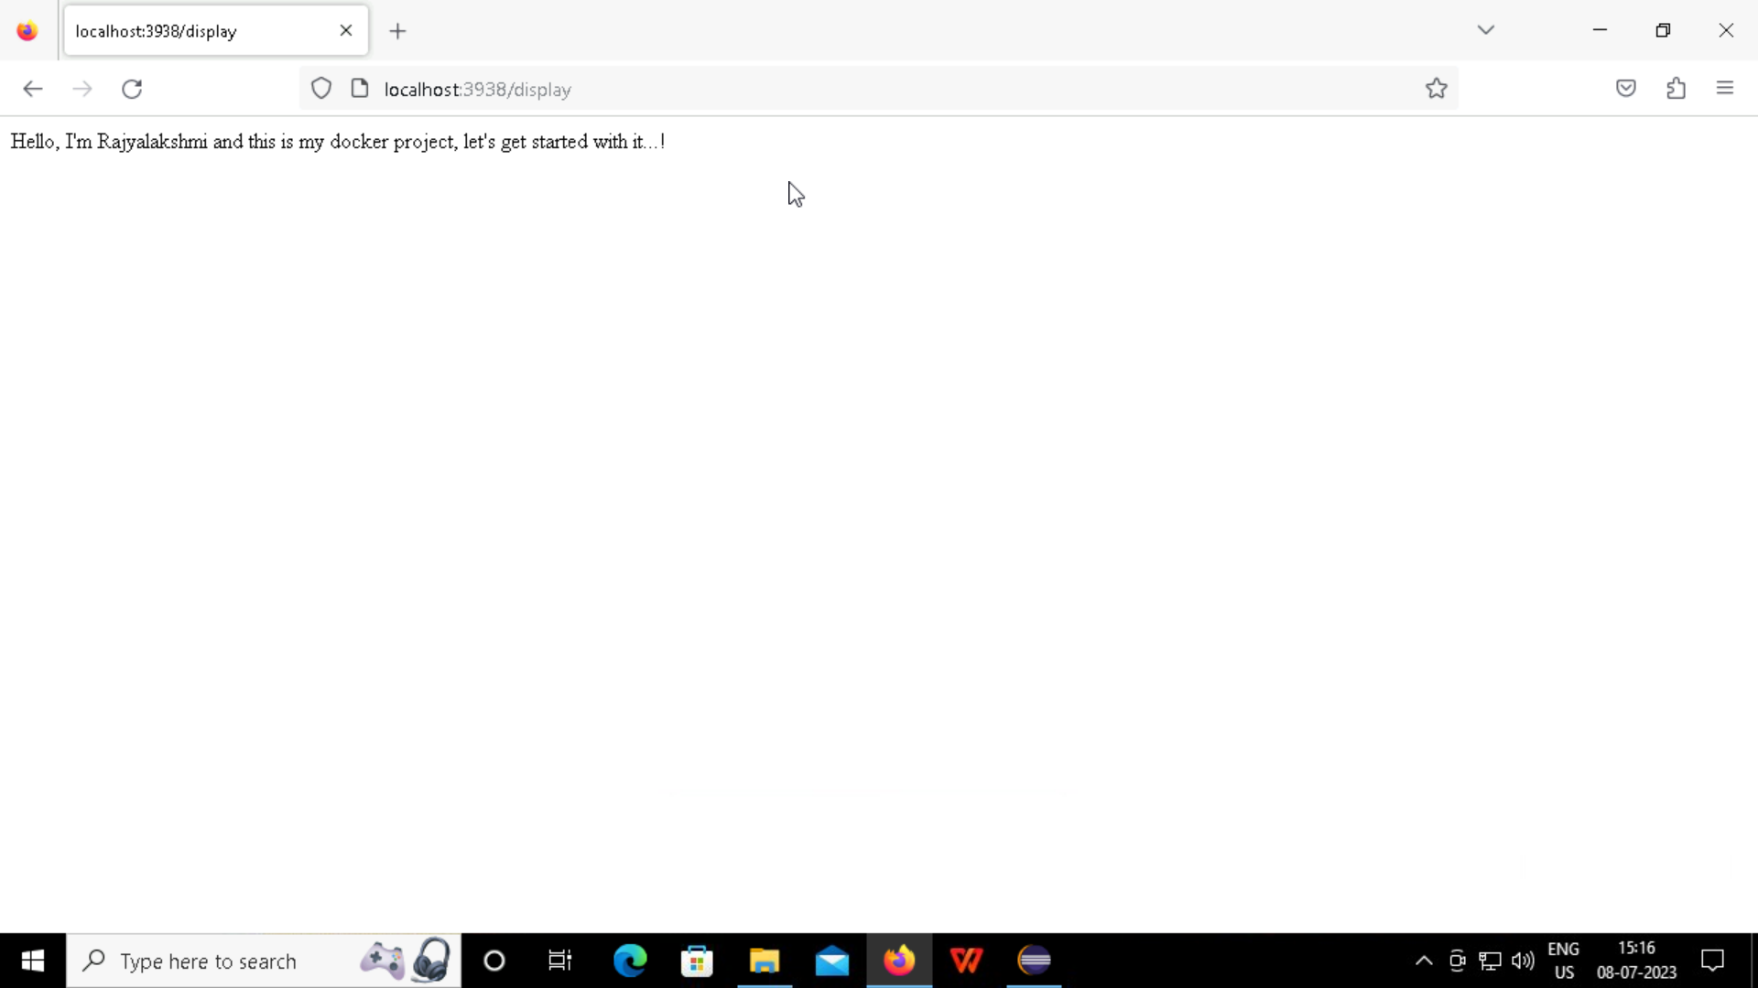
Step 2: The text in the code is displayed on the screen.

Slide 26
CREATING A DOCKER FILE

Slide 27
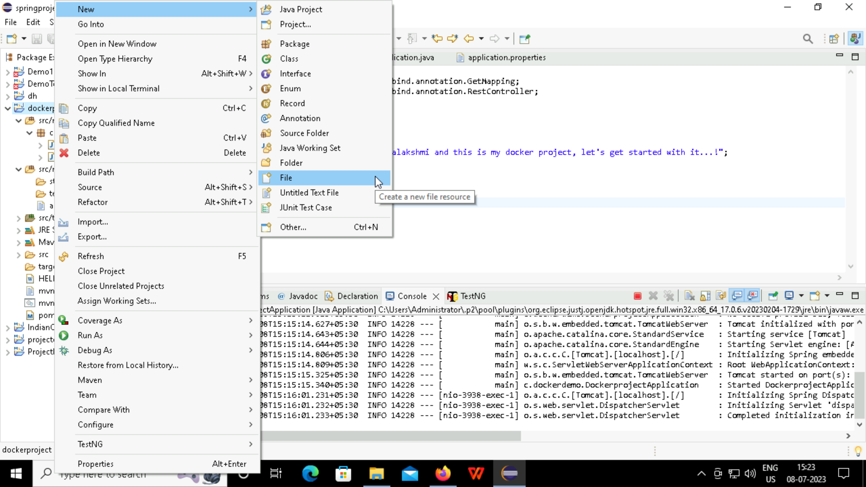
Step 1: Go to New> File> filename: Dockerfile

Slide 28
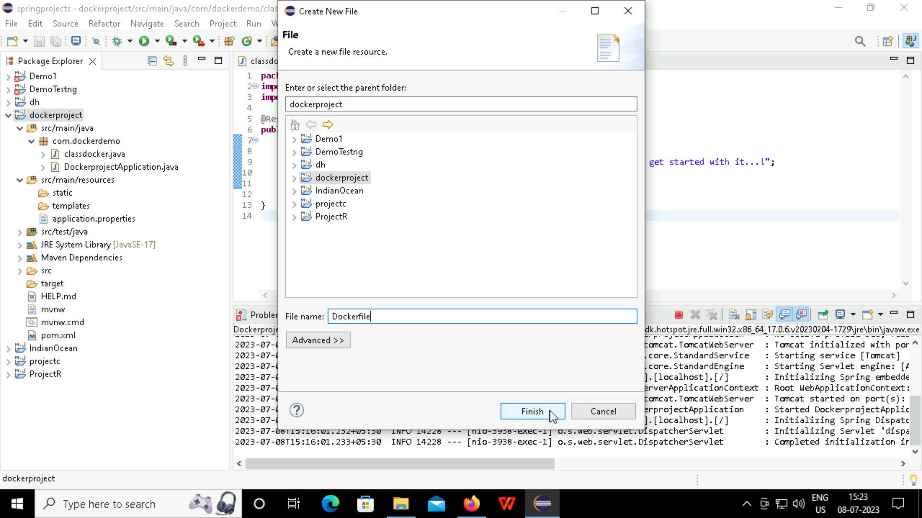
Step 2: After giving the name as Dockerfile, select finish and the dockerfile is displayed in the project.

Slide 29
CREATING JAR FILES

Slide 30
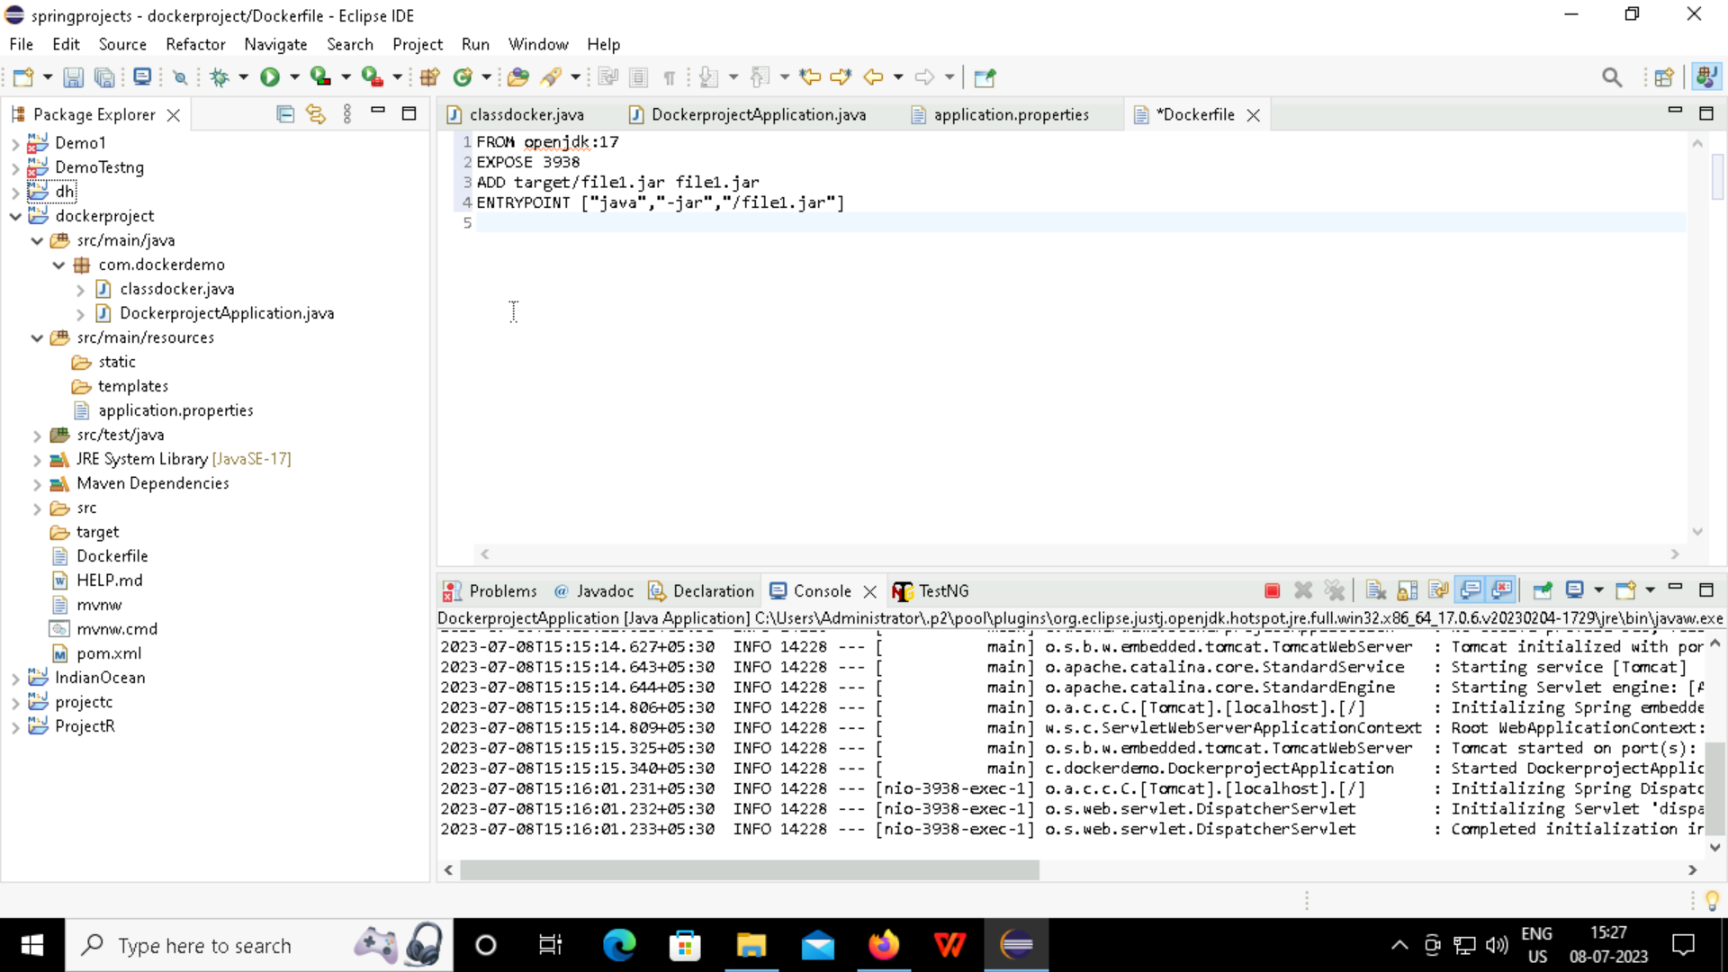
Step 1: Write the code in the docker file and in the entry point, give the name of the jar file.

Slide 31
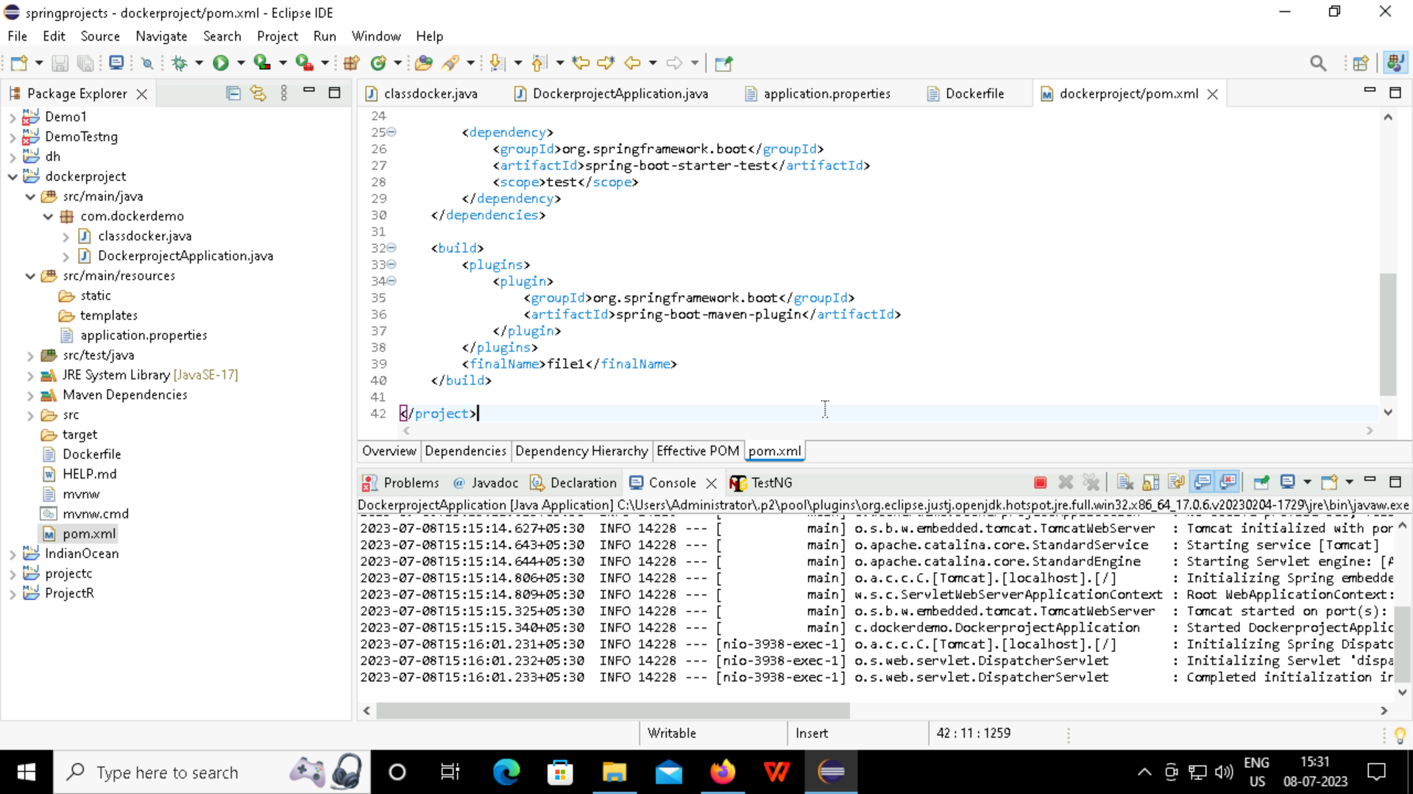
Step 2: Go to the pom.xml, in the </build>, </plugins>, give the jar file name and then save it.

Slide 32
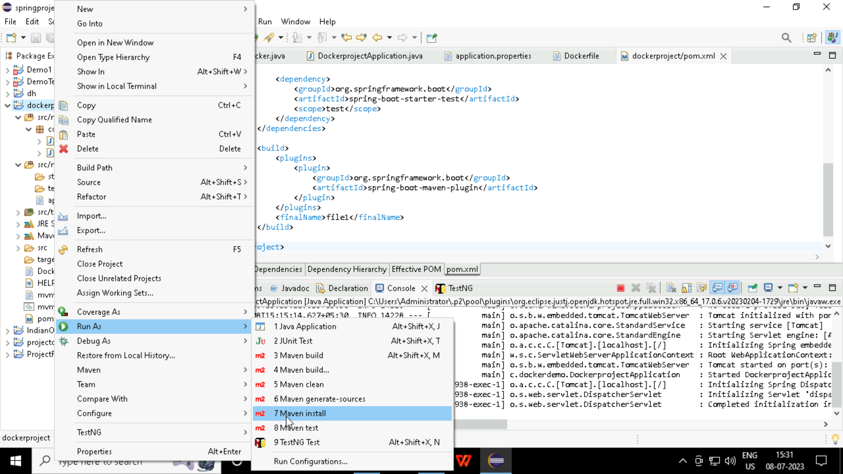
Step 3: Now run the code as Maven install.

Slide 33
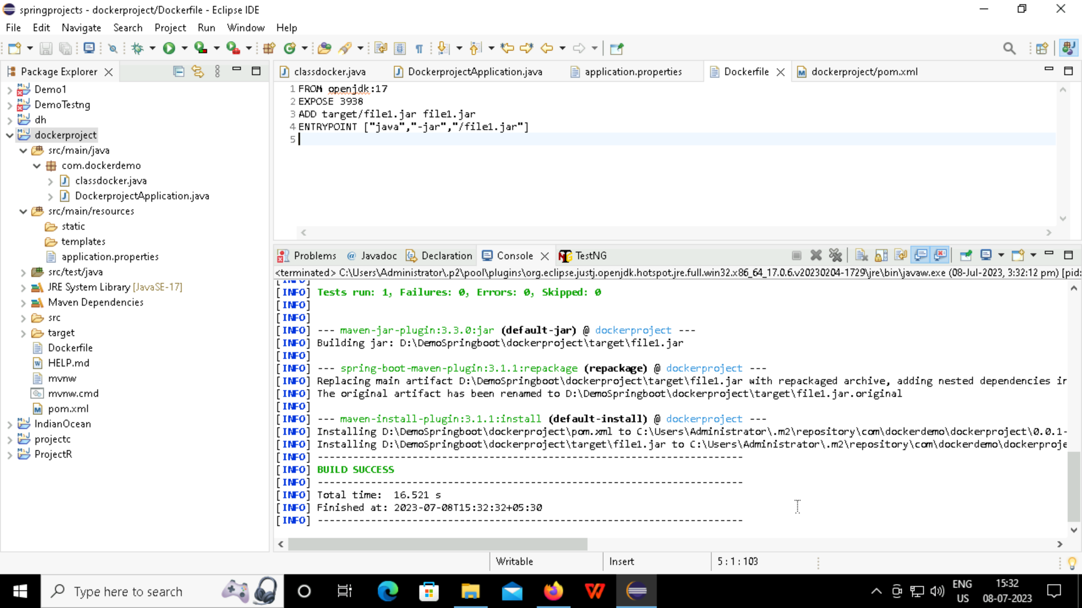
Step 4: Build Success represents the status that the docker file has been built.

Slide 34
CREATING DOCKER IMAGES and deploying the etst in browser

Slide 35
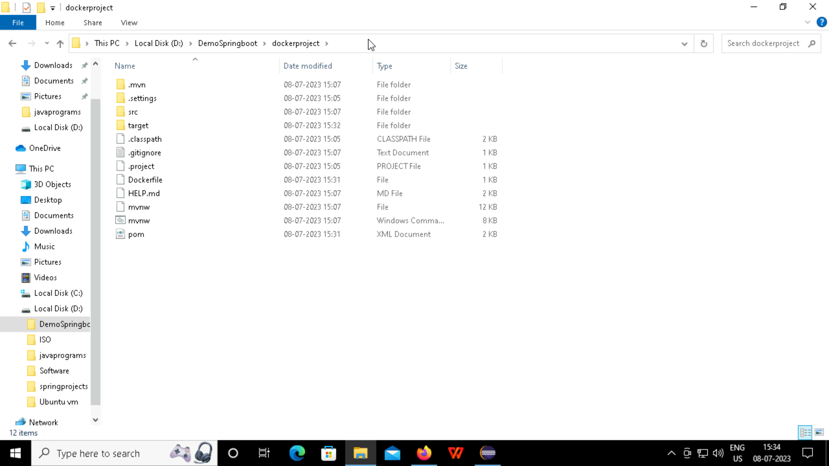
Step 1: Open the location where the docker project is located.

Slide 36
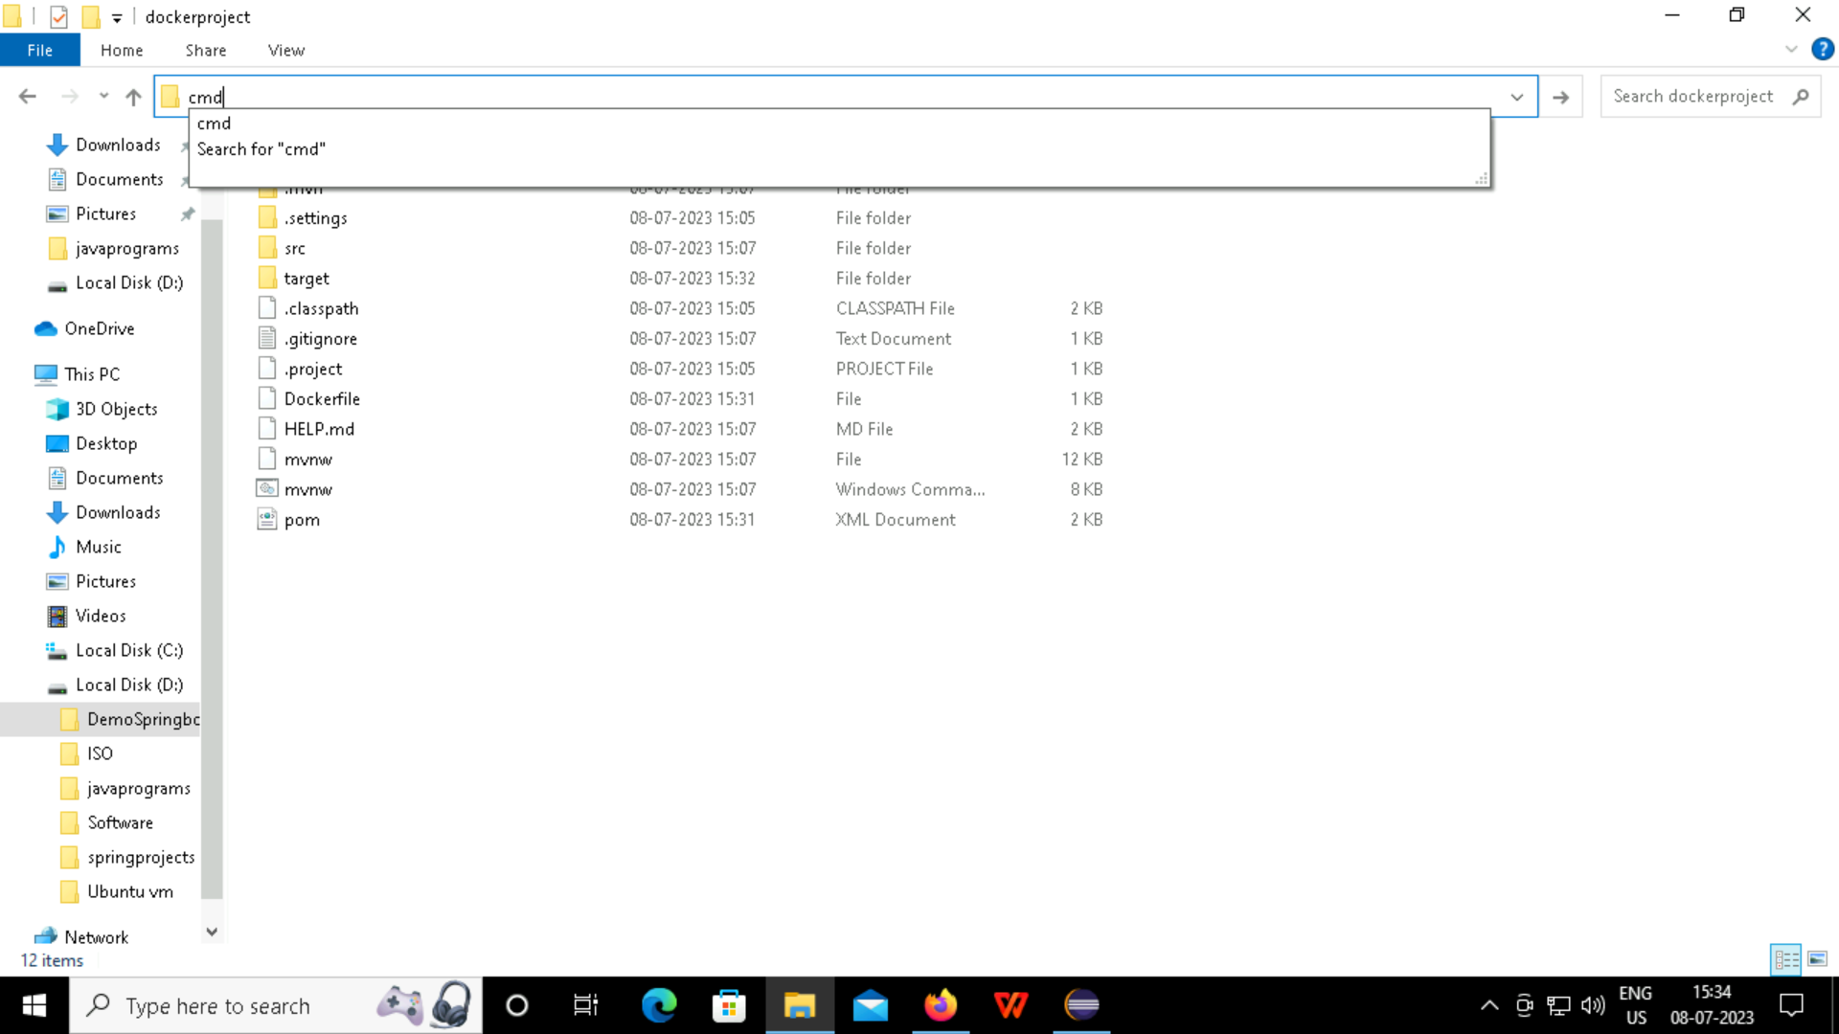
Step 2: Click on the path and type cmd, so the command prompt opens.

Slide 37
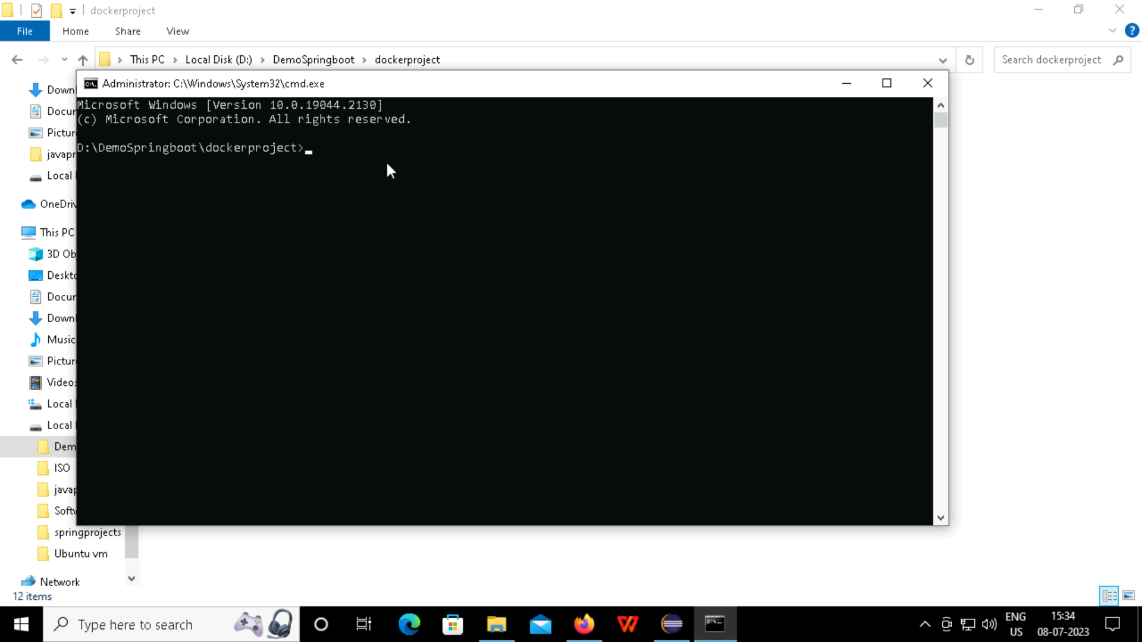
Step 3: This is the command prompt of the docker project

Slide 38
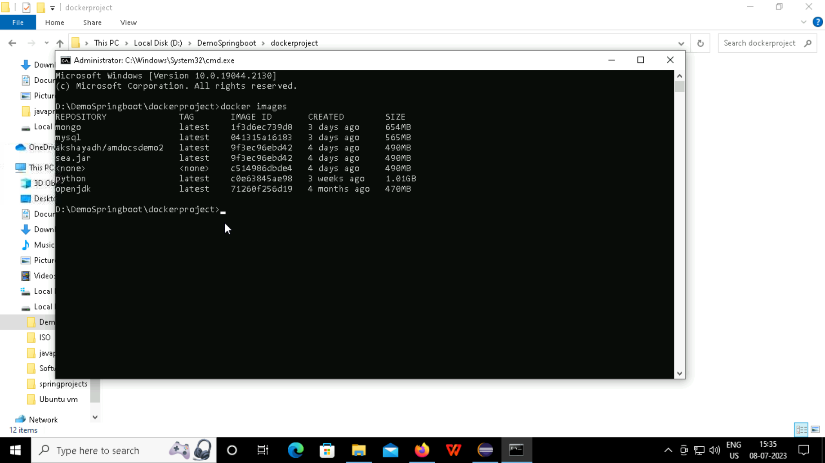
Step 4: Search the docker images using the command “docker images”.

Slide 39
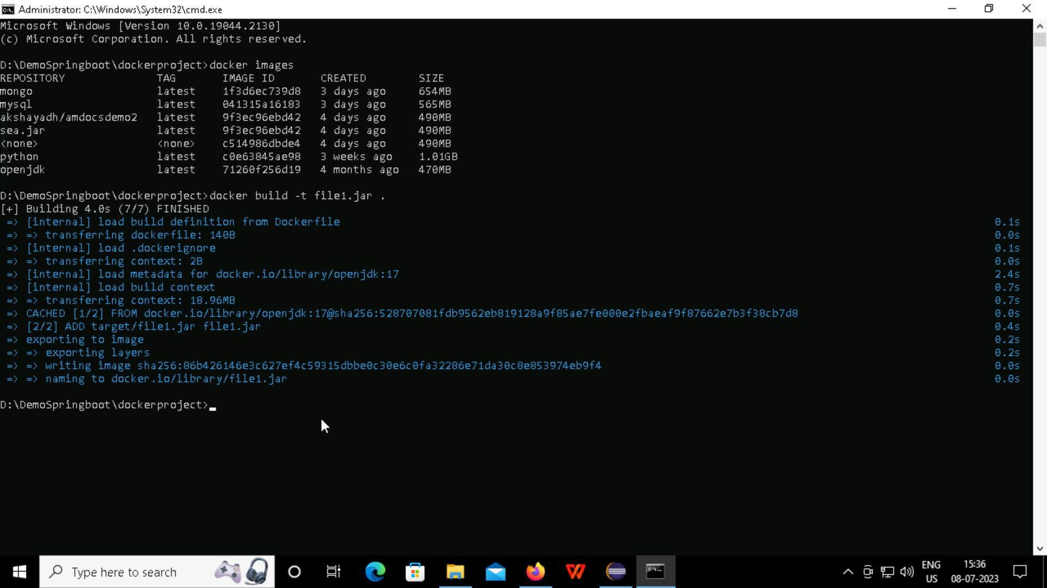
Step 5: To create a docker image of jar file, use the command “docker build –t (jar file name).jar” .

Slide 40


Slide 41
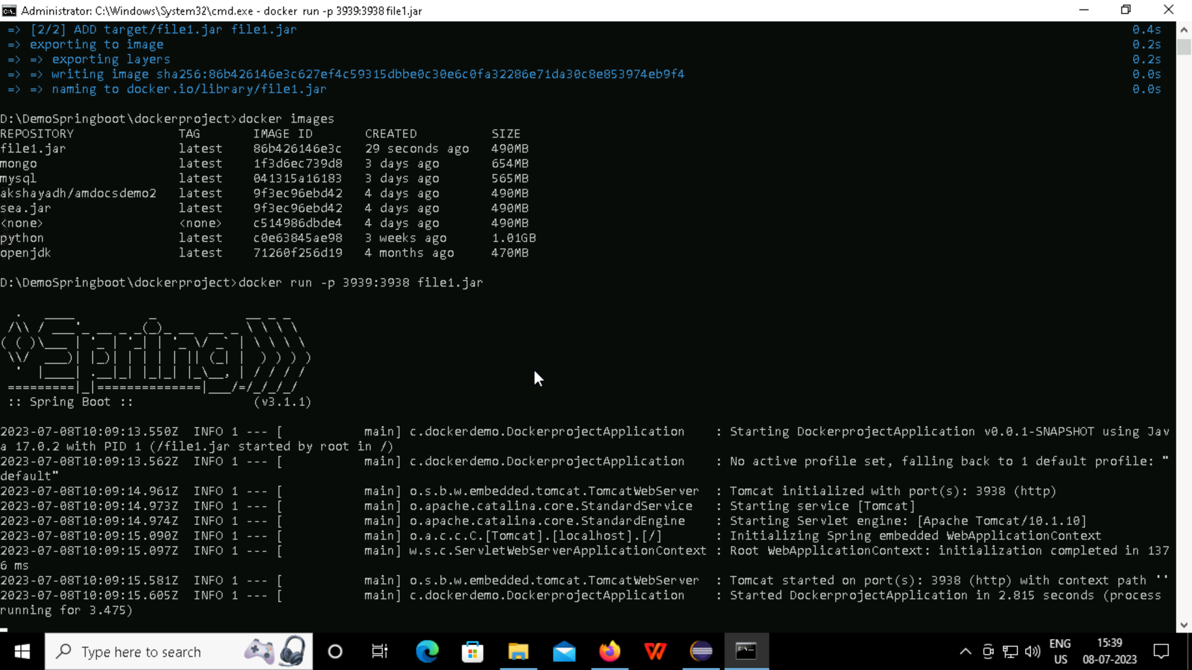
Step 6: Now run the jar file using the command “docker run –p (new port num)☹old port num) (jarfilename).jar.

Slide 42
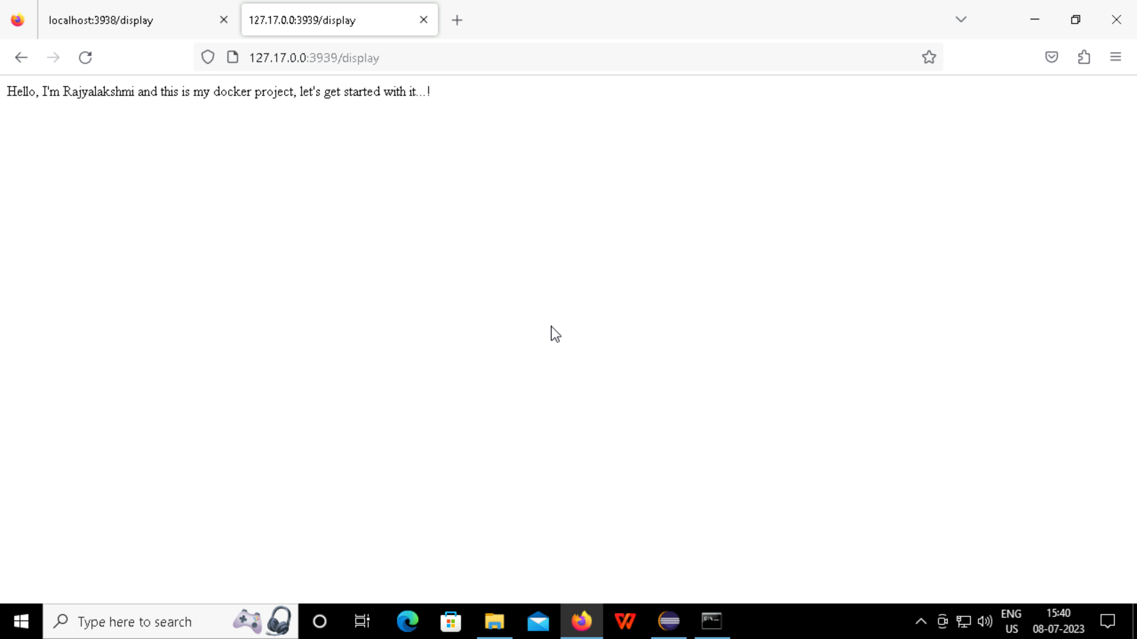
Step 7: Go to the browser and then give the IP address of the docker file as “127.17.0.0(new port number)/display” to view the text in the display.

Slide 43
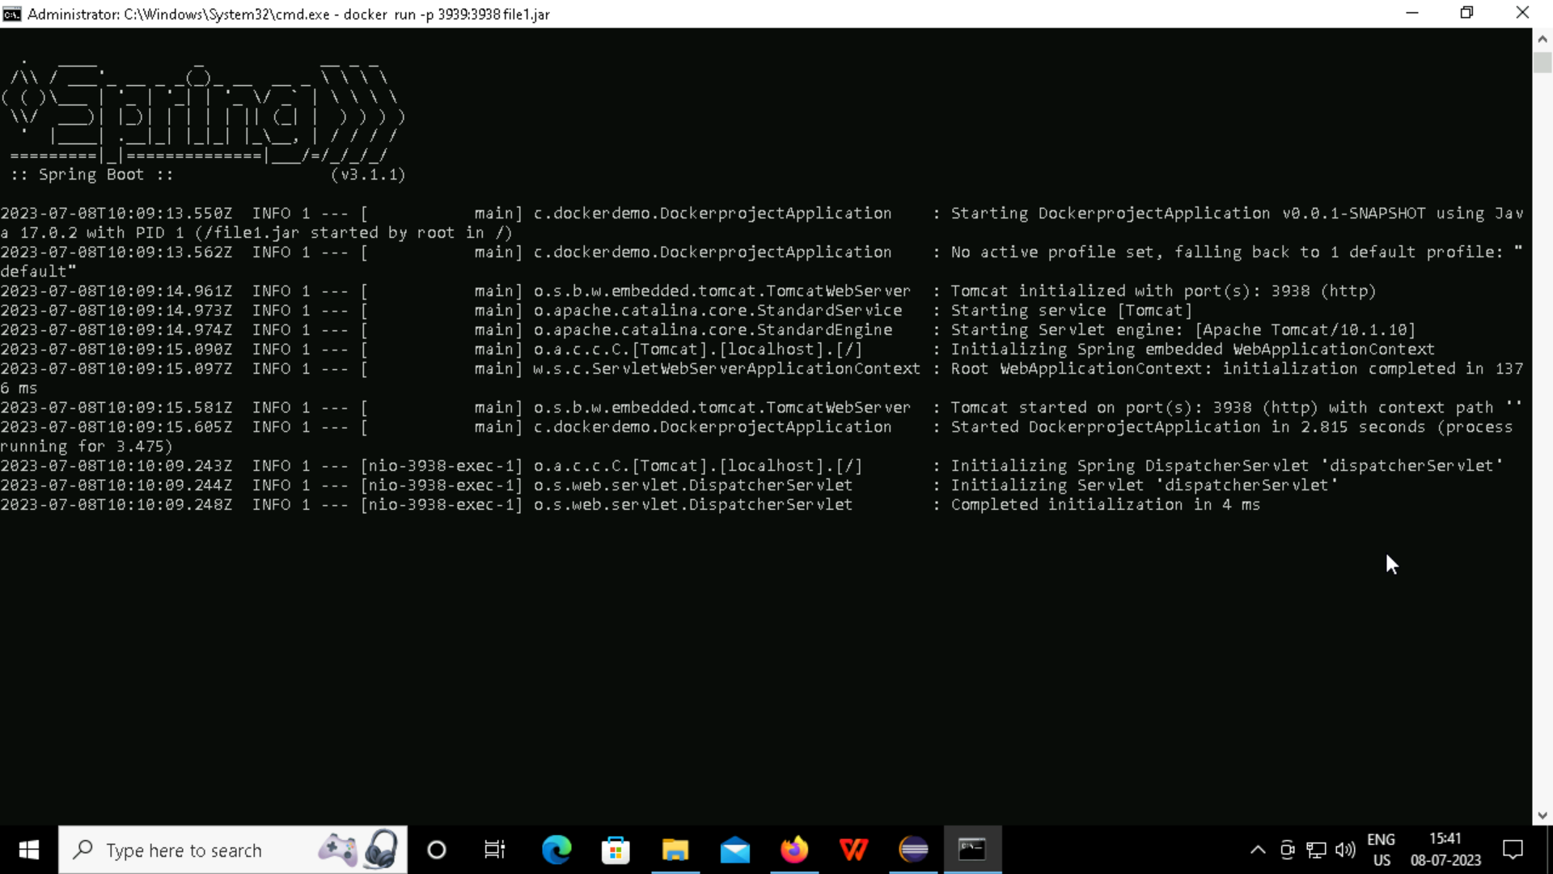
Step 8: The command prompt displays that the initialization has been completed and then ctrl+c/z to come out of the command prompt.

Slide 44
HOW TO PUSH THE DOCKER FILE INTO THE DOCKER HUB?

Slide 45
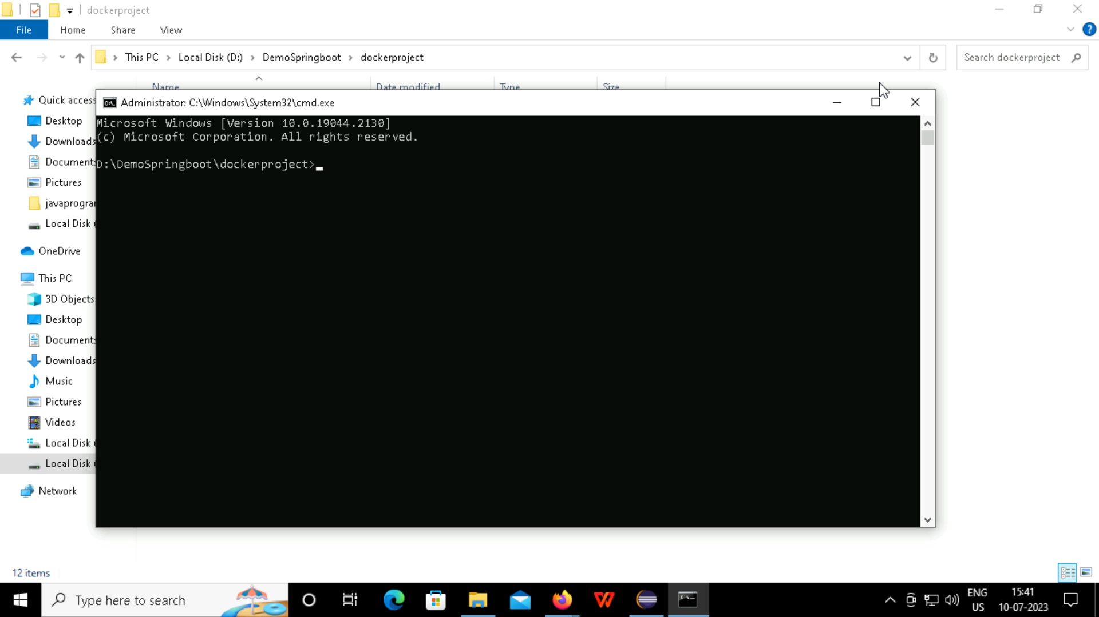
Step 1: Open the command prompt of the project file in the root directory.

Slide 46

Step 2: Check the version of the docker if you want to.

Slide 47

Step 3: Check the docker images using the command.

Slide 48

Step 4: Create a jar file and then give the username and the new jar file you want to replace with

Slide 49
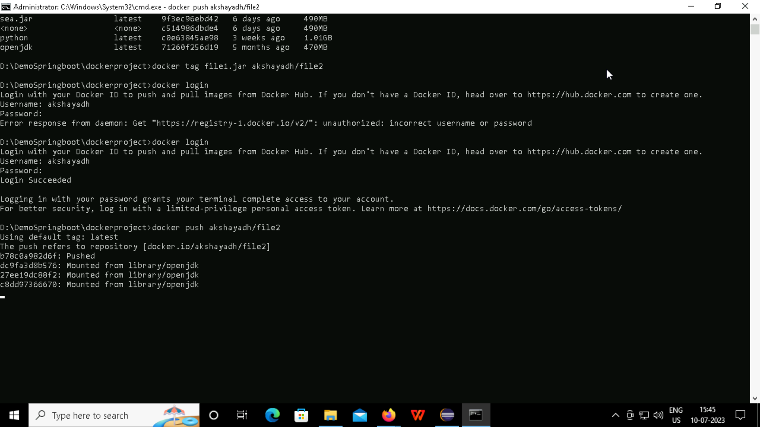
Step 5: Login to docker using the username and password to the dockerhub.

Slide 50
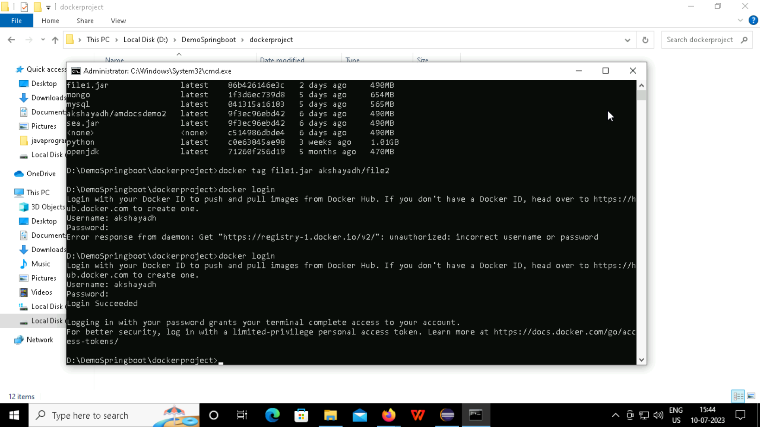
Step 6: Now push the docker file into the dockerhub using the push command.

Slide 51
Step 7: The status shows that the docker file has been successfully pushed into the docker hub.

Slide 52
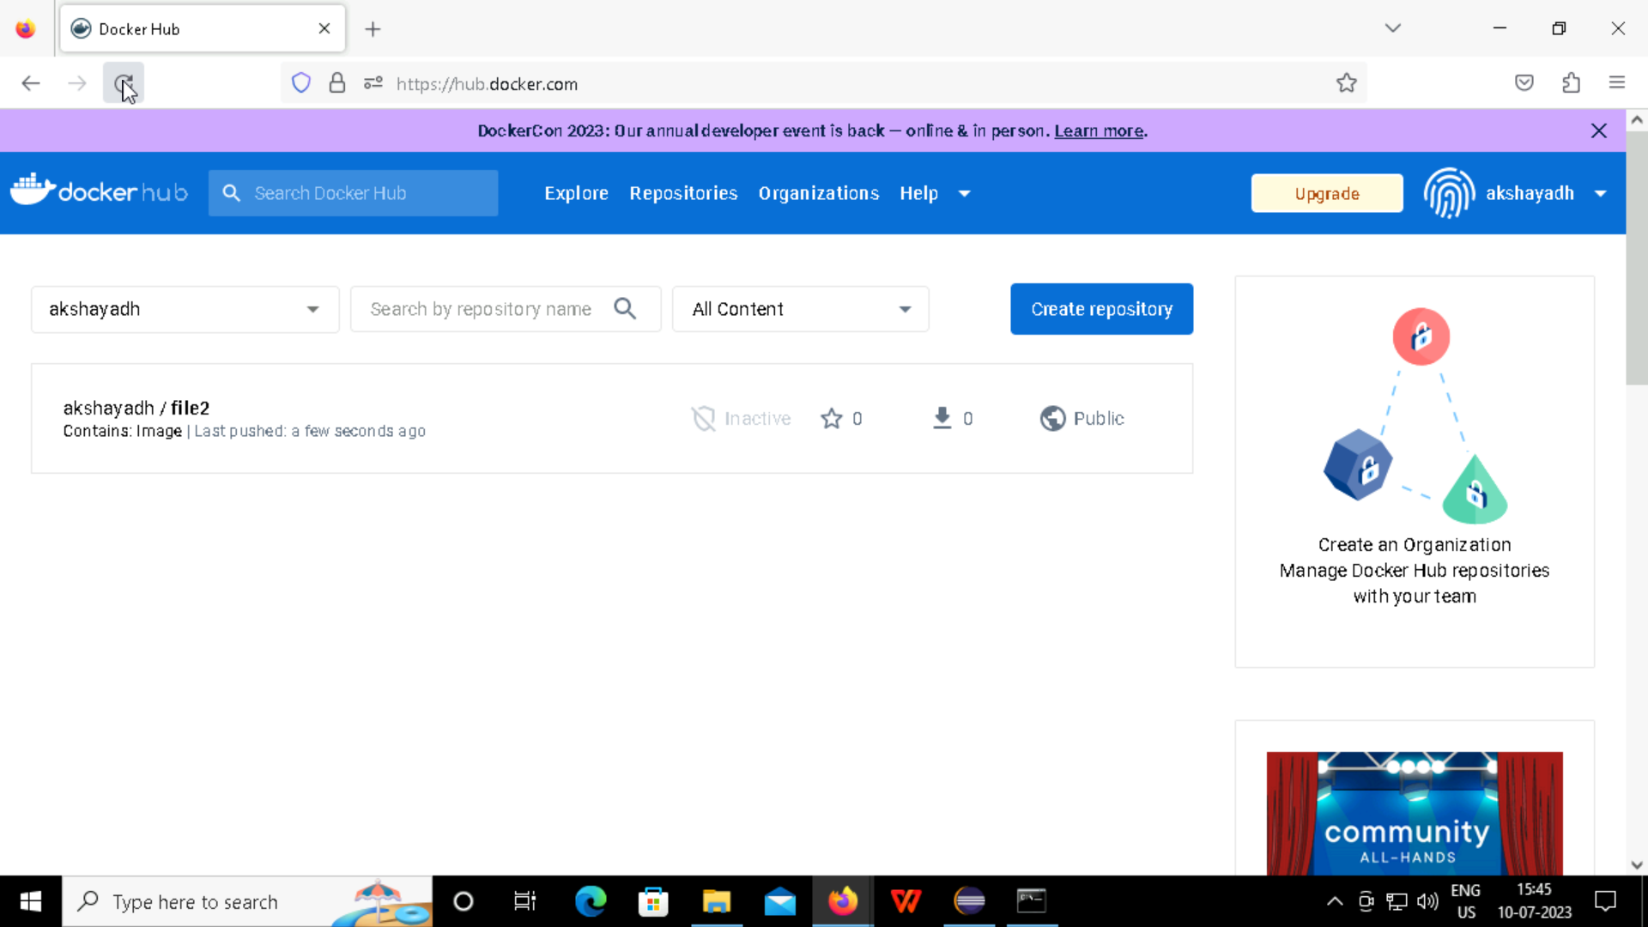
Step 8: Refresh the Docker Hub page to see the pushed docker file in the page.

Slide 53
SELENIUM EXECUTION USING CONVERSE

Slide 54
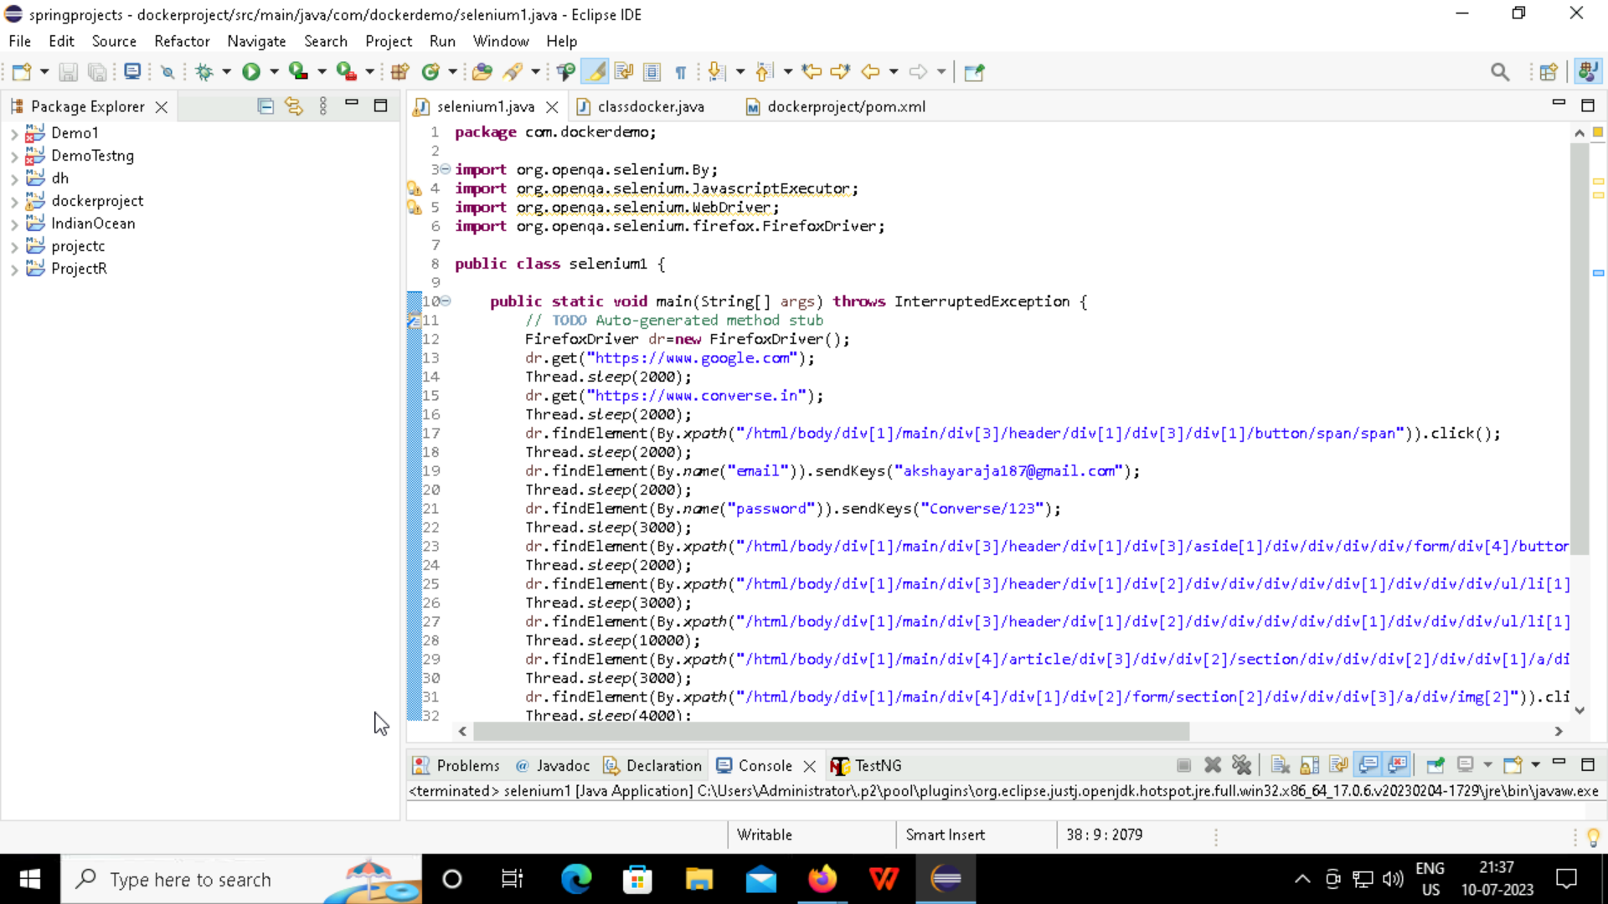
Step 1: Create a new class in the src/test, in that write the code for the automation selenium testing of the Converse shopping website.

Slide 55
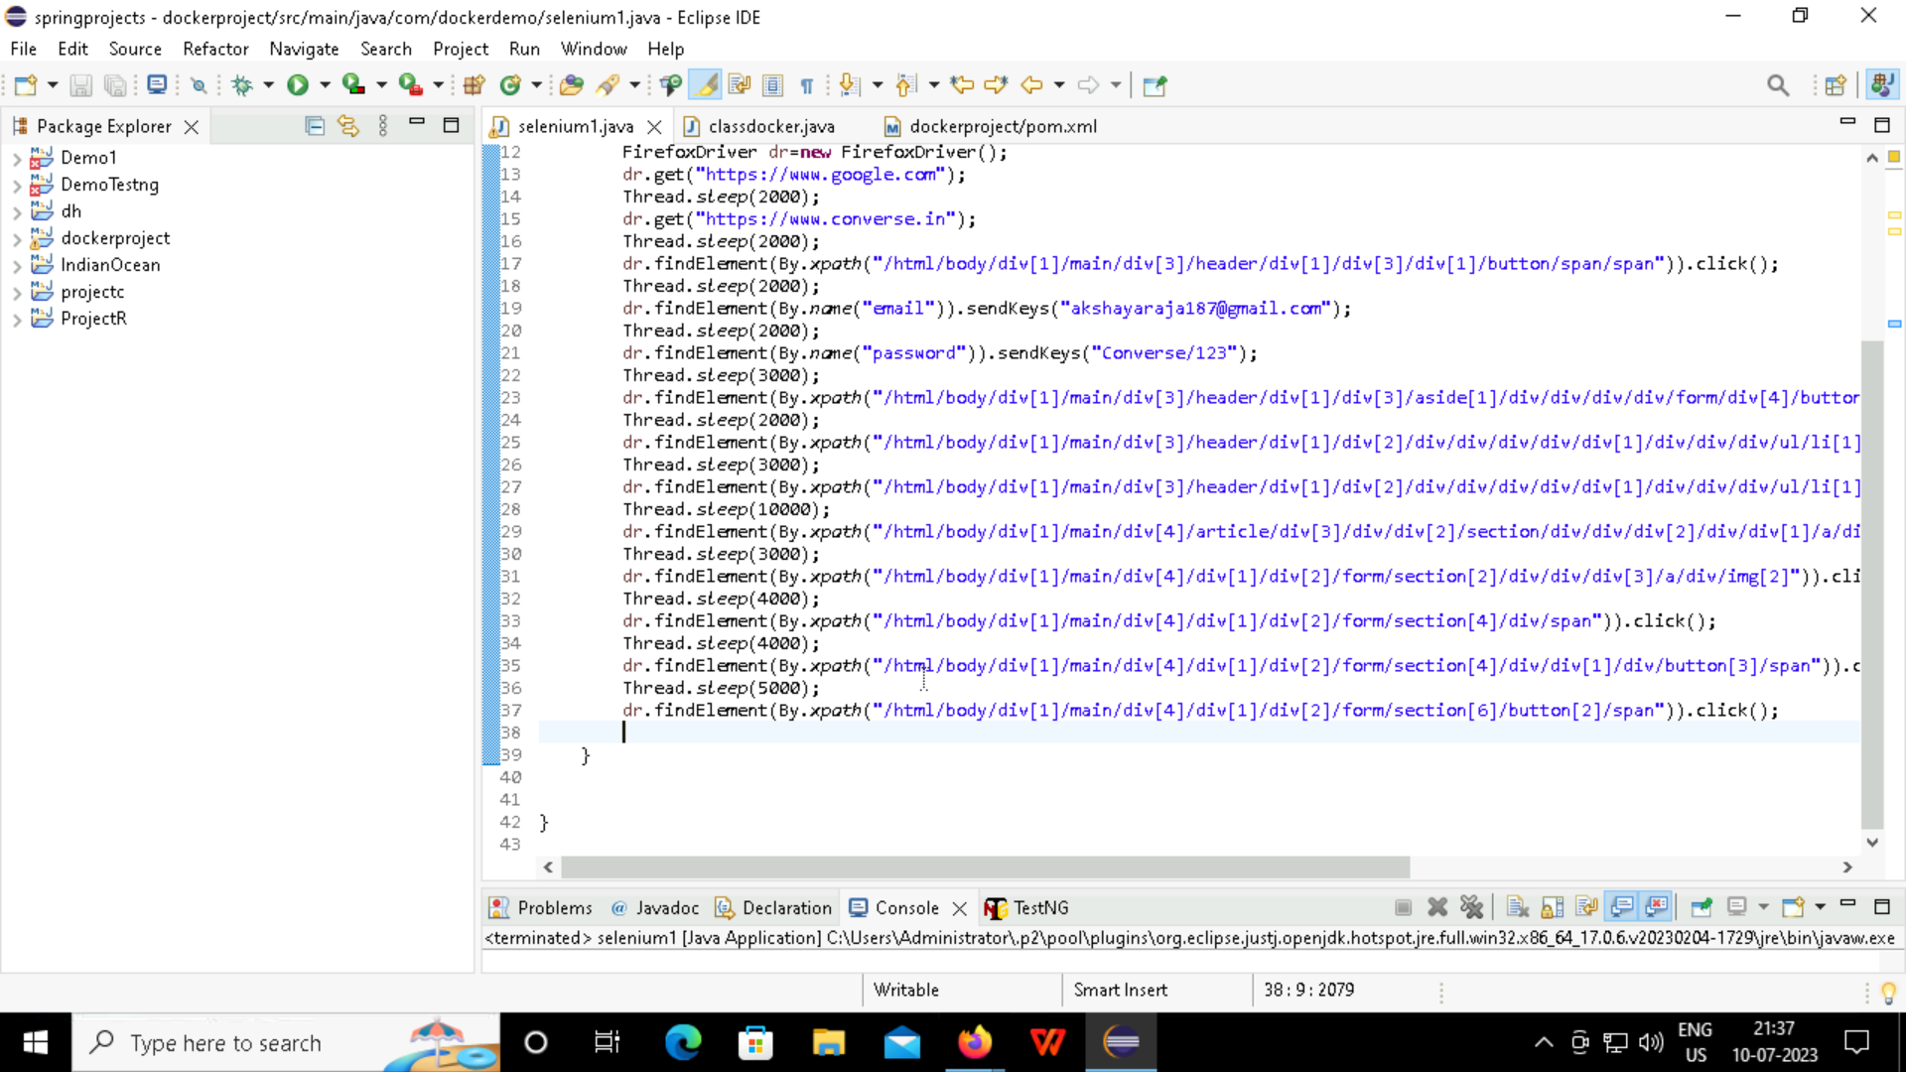
Step 2: Now run the code and see the automation run .

Slide 56
THANK YOU

